Slide 1
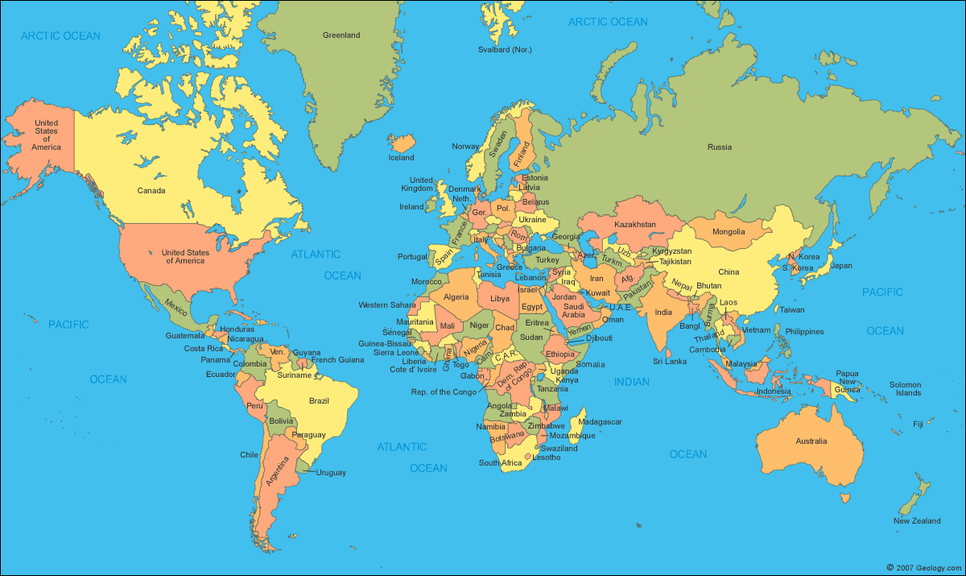
Bringing History Alive for Adult ESL Students
Central Southern Tier RAEN Conference
December 8 & 9, 2014
Victoria Capeci & Jolanta Olechowski

Slide 2
Objectives:
ESL & History
Welcome
Explore
Strategies for integrating history into ESL classes
History-related materials & resources
Notes:
Quick intro to each other & share out: program & population…. (many of them know each other)

Slide 3
Adult ESL Students
Why History?
How can integrating the study of history and English enrich our ESL classes?
What kinds of history-related activities have you done in your ESL classes?
What are potential pitfalls of dealing with history in ESL classes?
Notes:
Group discussion – share out
Citizenship, can integrate into new country/society more easily, build community in the classroom, as grown-ups, it’s good to expand our knowledge base, it’s interesting

Slide 4
Tools of the Trade
ESL & History
The basics students need to explore history in English

Slide 5
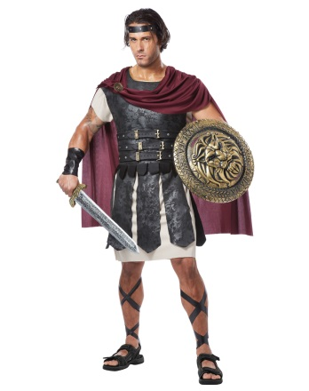
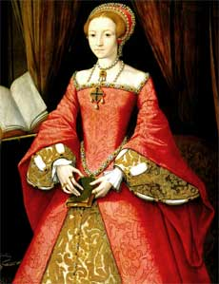
ESL & History: Tools of the Trade
When?
Basic numbers
Years
Hundreds Game

Slide 6
ESL & History: Tools of the Trade
Where?
Words & Maps

Slide 7
ESL & History: Tools of the Trade
Who?
People and Places

Slide 8
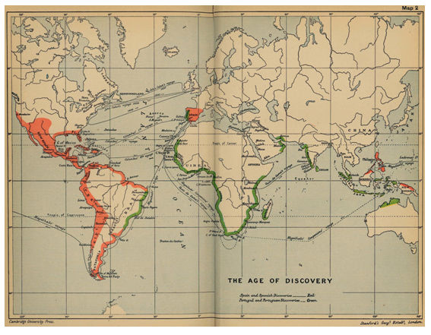
ESL & History
Building Context
Colonies and Independence

Slide 9
Why did colonists go to other countries?
So France was in Africa, Spain was in South America, and England was all over the place.
Why?
$$$
Religion
Freedom
The who, where, and when help students navigate the why.
Notes:
Why – our favorite history question: The tools of the trade (who, where, when) help you navigate the why.

Slide 10
ESL & History
Building Context
Colonies and Independence
Why assign countries?
Students all from one country
Weaker English language skills
Expose students to a variety of countries

Slide 11
ESL & History
Building Context
One size does not fit all.
Activities need to be tweaked according to students’
general education level
English language skills: reading, writing, speaking, listening
Every class is different
Notes:
Do version 2 here

Slide 12
ESL & History
Building Context
Colonies and Independence
Take 2: Class Independence Timeline
The Class
Core group with strong listening/speaking skills
Almost everyone: emerging readers & writers, very limited formal ed.
A few students with very weak speaking & listening skills
A nurse from Brazil
Worldly
Notes:
More open-ended

Slide 13
ESL & History
Building Context
Class Independence Timeline
It gets messy….
Open-ended questions don’t have a single, definitive answer
Students disagree on dates
Students are unsure about their own country’s history
Concept of civil war vs. war of independence
Date independence declared or recognized (Brazil: declared in 1822, recognized by Portugal in1825)
Territory vs colony (Puerto Rico)
Some countries gained independence more than once, from more than one country (Dom. Republic: Spain 1821 & Haiti 1844)
Notes:
If you’re looking for pat answers, history is not for you

Slide 14
ESL & History
Building Context
Class Independence Timeline
It gets messy, but that’s a good thing.
Resolving ambiguity gives students lots of language practice.
“Messy” issues engage students in meaningful conversations.
Accustom students to the idea of point of view.
Generate interesting questions for follow-up.
Community building: Students solve problems together and learn about each other.
Note: Just be sure to keep the conversations going in English.

Slide 15
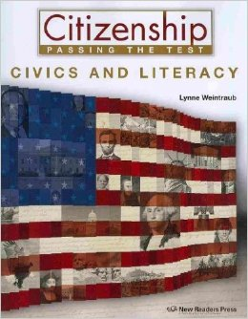
ESL & History
Textbook
History
Geography
Civics
Citizenship Test
Notes:
Hand out the textbook

Slide 16
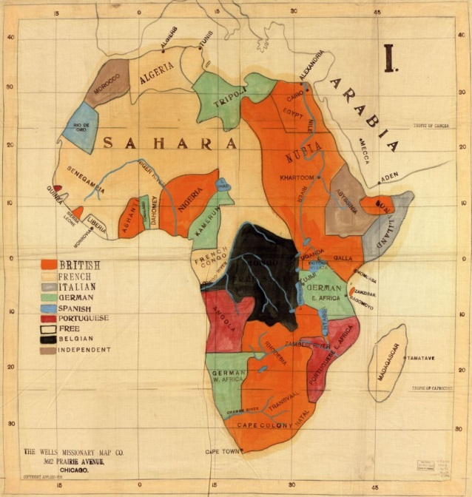
ESL & History
Navigating Text
Civics (History and Government)
Questions for the Naturalization Test
Primary and Secondary Sources
Notes:
In this workshop, we’ll focus on secondary sources, specifically this textbook

Slide 17
constitution
ESL & History: Negotiating Text
There are words….
apple
flower
…… and words
emancipation
colonists
slavery
Need context and background knowledge to navigate abstract, academic vocabulary

Slide 18
ESL & History
Navigating Text
Chapter Three: 13 Colonies (Page 36)
Take a look. What do you notice?
Textbook has just a few pages per major period in U.S. history
Not much text on the page, but it’s abstract
Deceptive: Just because it’s a literacy-level text doesn’t mean you’re ready to roll
It’s important to unpack even a literacy-level ESL text.
Notes:
Look at the title of the chapter: 13 Colonies
Imagine looking at the title of Chapter 3, “13 Colonies” cold, with no prep. It’s too abstract.

Slide 19
ESL & History
Active Reading
Chapter Three
13 Colonies
Page 36

Slide 20
ESL & History
Extension: Making Connections
Citizenship: The 100 Questions
Q.
What do we know about The 100 Questions?
A.
They read like a phone book.
Notes:
Review problems

Slide 21
ESL & History
Extension: Making Connections
Citizenship: The 100 Questions
American History
Colonial Period and Independence
58. What is one reason colonists came to America?
(This is the first question in the section on American history.)

Slide 22
ESL & History
Extension: Making Connections
Citizenship: The 100 Questions
American History
Colonial Period and Independence
58. What is one reason colonists came to America?
▪ freedom
▪ political liberty
▪ religious freedom
▪ economic opportunity
▪ practice their religion
▪ escape persecution

Slide 23
ESL & History
How can we help our adult students experience history is accessible, interesting, and useful?
Know your students: plan accordingly
Scope: break it down, smaller chunks, dig deeper
Background knowledge: capitalize on the students’ life experiences
Concrete to abstract: provide students with navigation tools
Plenty of time to grapple with the material, repetition is good
Make it fun: give students a chance to interact and communicate with each other
Notes:
Closing discussion

