Slide 1
USING ASISTS REPORTS TO GUIDE INSTRUCTIONAL SUPPORT

Slide 2
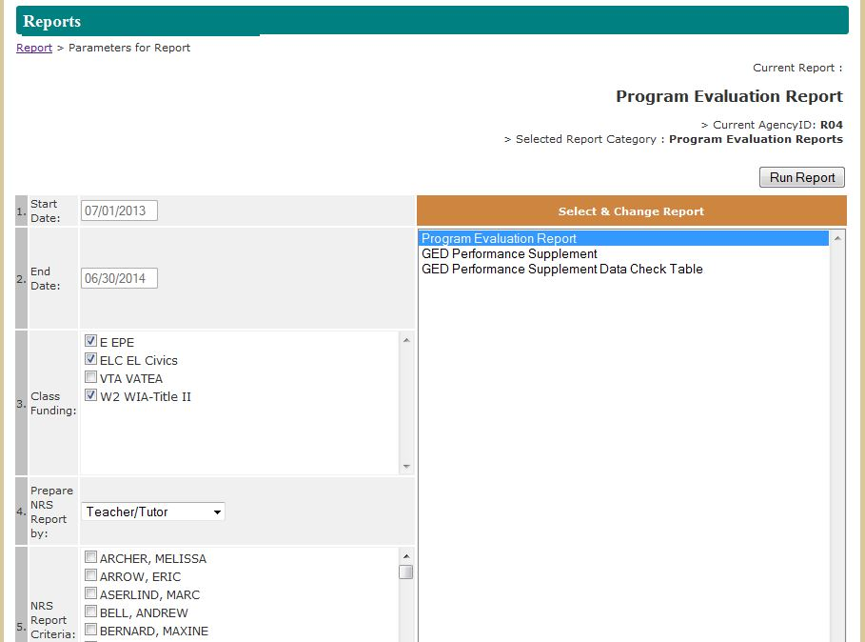
Program Evaluation Report
Path in ASISTS to the Program Evaluation Report:
Funding Reports 2014 > Program Evaluation Report

Slide 3
Analyze the Data for Teacher A
At what NRS levels are the students clustered?
Compare the educational gain for each level to the targets.
What pattern do you see?
What conclusions would you make?
What are some things you can do to support Teacher A instructionally?
Notes:
Group should identify that this teacher has been more effective with lower ABE levels than higher ones, effectiveness decreased as the level increased.
Elicit responses. Sample next steps: observe class with a focus on upper level students, is the work challenging enough, do they have appropriate materials, is the instruction differentiated enough, etc.

Slide 4
Analyze the Data for Teacher B and C
Compare the educational gain for each level to the targets.
What patterns do you see? How are these different for Teacher B and Teacher C? What conclusions would you make?
What are some things you can do to support each teacher?
What further data do you need?
Teacher B
Teacher C
Notes:
Elicit conclusions: Teacher A is more effective with higher level ESL students, Teacher B is more effective with lower level ESL students.
Elicit sample next steps: In each case observe the class: differentiation, grouping, materials, etc.
Next thing needed: To know who these students are (lead in to Student Assessment and Attendance Report.

Slide 5
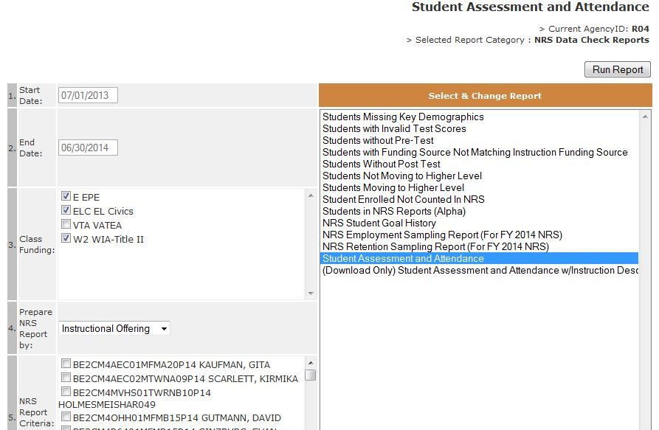
Student Assessment And Attendance Report
Path in ASISTS to the Student Assessment and Attendance Report:
Funding Reports 2014 > NRS Data Checks > Student Assessment and Attendance Report

Slide 6
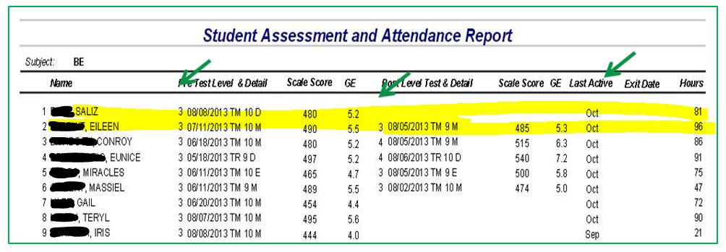
Student Assessment And Attendance Report
Gives a complete picture of your class including whether a student has made educational gain.
Lists the most recent post-test and identifies students who have not been post-tested.
Identifies the last month for which a student has attendance in ASISTS

Slide 7
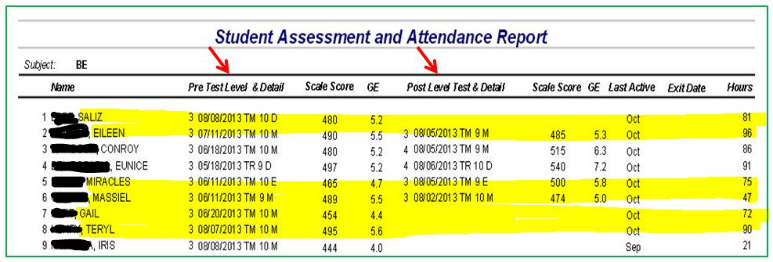
Student Assessment And Attendance Report: Identify Students’ Lowest Area
For BE Students: Use the Pretest Details column to identify the lowest area for students who have NOT made gain.
TM = TABE Math / TR = TABE Reading
In what area do most students need to make gain?

Slide 8
Student Assessment And Attendance Report: Identifying Be Cusp Scores
For BE: Use the Grade Equivalent Columns to identify students on the Cusp.

Slide 9
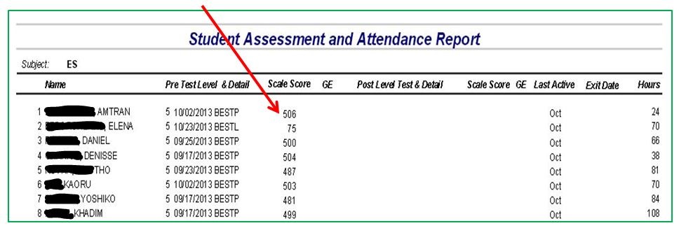
Student Assessment And Attendance Report: Identifying ESL Cusp Scores
For ESL: Use the Scale Score Column to identify students on the Cusp. Remember to use BOTH the BEST Plus and BEST Literacy Cusp Guides.

Slide 10
TABE RANGES AND CUSP SCORES
NRS Level | Educational Level | TABE Range | Cusp Range
1 | Beginning ABE Literacy | 0 – 1.9 | 1.7 – 1.9
2 | Beginning ABE | 2.0 – 3.9 | 3.7 – 3.9
3 | Low Intermediate ABE | 4.0 – 5.9 | 5.7 – 5.9
4 | High Intermediate ABE | 6.0 – 8.9 | 8.7 – 8.9
5 | ASE Low | 9.0 – 10.9 | 10.7 – 10.9
BEST PLUS RANGES AND CUSP SCORES
NRS Level | Educational Level | BEST Plus Range | Cusp Range
1 | Beginning ESL Literacy | 85 – 400 | 385 – 400
2 | Low Beginning ESL | 401 – 417 | 413 – 417
3 | High Beginning ESL | 418 – 438 | 433 – 438
4 | Low Intermediate ESL | 439 – 472 | 465 – 472
5 | High Intermediate ESL | 473 – 506 | 500 – 506
6 | Advanced ESL | 506 - 540 | 536 – 540
BEST LITERACY RANGES AND CUSP SCORES
NRS Level | Educational Level | BEST Literacy Range | Cusp Range
1 | Beginning ESL Literacy | 0 – 20 | 17 – 20
2 | Low Beginning ESL | 21 – 52 | 47 – 52
3 | High Beginning ESL | 53 – 63 | 59 – 63
4 | Low Intermediate ESL | 64 – 67 | 65 – 67
5 | High Intermediate ESL | 68 – 75 | 71 – 75
6 | Advanced ESL | Not valid as pre-test | Not valid as pre-test

Slide 11
Using The Student Assessment and Attendance Report
Can be run by region, site, teacher and class.
Shows each student by level and:
Whether they have made educational gain and have a post-test.
Total number of hours in the program.
Last month of attendance.
Lowest area and whether they are on the cusp.

Slide 12
Compare Teacher C and Teacher D
TEACHER C
TEACHER D
Notes:
Based on Performance Evaluations, both teachers have low educational gain rates. Both teachers have higher rates of gain with their lower level students (Note: explain that 6 or 2 students is too small a group to draw conclusions.)
Discuss the effect of post-testing on educational gain, but conversation should return to other causes of educational gain.
Need to look at Student Assessment and Attendance to determine what student needs are.

Slide 13
Teacher C Student Assessment and Attendance Report
Notes:
Class is mixed between students whose primary need is reading and math.
Elicit responses. Next steps: Observe class. Is differentiation of instruction occurring? There is a higher rate of gain at the lower level regardless of if the student needs reading or math. Are upper level students in both areas getting the instruction/materials they need? Does the teacher feel as comfortable with upper level material? Is the teacher focusing on the lower level students primarily, etc.

Slide 14
Teacher D Student Assessment and Attendance Report
Notes:
Students in class overwhelmingly need math.
Elicit responses. Next steps: Observe class. Is enough time spent on math? How confident does the teacher seem with content area in math, particularly at higher levels? Are the materials appropriate, etc.

Slide 15
Analyzing ESL 1 Classes
Review the Program Evaluation and the Student assessment and Attendance Report.
Which students are showing increases in their test scores? Is there a difference between higher and lower level ESL 1 students?
What is one thing the teacher could work on?
Notes:
Students are clustered at ESL 1, which has a low rate of educational gain. (Note that levels with 1 or 2 students have to few students to analyze.)
Elicit response that next step is to see who these students are (Student Assessment and Attendance Report).

Slide 16
ESL 1Student Assessment and Attendance Report
Notes:
Have group note differences in ESL 1 students.
Are lower ESL 1 students showing progress?
Are higher level ESL 1 students making educational gain? Are they being challenged enough or lost among the lower level students? Is there a pattern of students dropping out after post-testing? How could the teacher keep students from getting discouraged?
What are things to look for when observing the class?

Slide 17
Analyzing ESL Class Data
Which students are not making gain?
What support can you offer the teacher?
Notes:
Have group note that there are BEST Plus and BEST Literacy students.
Which students are the ones making gain? (Note: BEST Literacy students are not the ones making gain.)
How would you respond? Sample responses: Make sure teacher is aware of who their BEST Literacy students are, differentiation of instruction to include more reading and writing for BESTL students, appropriate materials for this group, etc.

Slide 18
Analyzing ESL Class Data
Which students are not making gain?
What support can you offer the teacher?
Notes:
Group should be able to note that students at the higher level are staying longer (Average Contact Hours) and making more gain.
Sample next steps: Observe class, differentiation of instruction, materials, is the class taught at too advanced a level for the beginning students?

Slide 19
Analyzing Post-Test Rates
Compare Teacher A and Teacher B’s Program Evaluations. Then Compare their Student Assessment and Attendance Reports.
What are the similarities between these two teachers?
What are the differences?
Teacher A
Teacher B
Notes:
Group should note that overall post-test rates are almost identical for the two teachers.
Need more detail on the class, particularly on retention (Student Assessment and Attendance Report) and Average Contact Hours.

Slide 20
Analyzing Post-Test Rates
What conclusions can you make?
What actions will you take? How are they different for Teacher A than for Teacher B?
Teacher A
Teacher B
Notes:
Teacher A retained 12 of 15 students; Teacher B retained 5 out of 14 students.
Sample next steps for Teacher A: Is the teacher certified? Figure out where there was a break-down in the post-testing process.
Sample next steps of Teacher B: Observe class, is there an instructional cause for poor retention? Given low rate of gain for post-testers, what instructional issues might be present? What follow-up is done with students who stop attending? Have these students been contacted to find out reasons for leaving?

