Slide 1
Keys to the TASC and Beyond: Strategies to Improve Literacy Outcomes Across the Adult Ed.
Presented by: Lavern Nelson
NYC RAEN Director

Slide 2
Outcomes
Explore CTB’s Greatest Achievement Gap Between Passing and Non-passing TASC Test documents for reading, writing and vocabulary
Engage with standards based research tasks that supports learners at all levels
Discuss the implication for classroom instruction

Slide 3
Reading & Writing Structure
Read through both documents
What Turn –and Talk
  What are your noticing?
  What are wondering?
  Questions
Notes:
Have pairs engage in a quick five minutes discussion

Slide 4
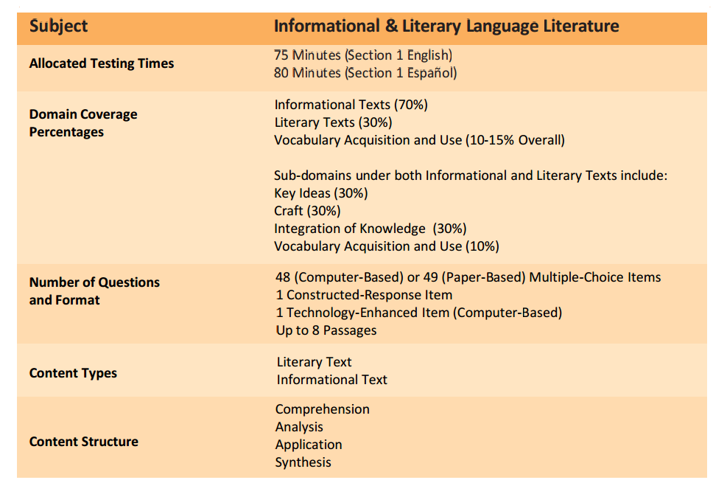
2015 TASC Reading Structure
Notes:
Take 10 minutes, use highlighters and post-its to review the documents, chart noticing's, and at least two wondering that comes to mind as a result of previewing the document.
Respond to this question:
In what ways is the word “Analyze” use in the Greatest Achievement Gap document? What is the implication for classroom instruction?
How is vocabulary addressed through the reading and writing?

Slide 5
TASC Writing Structure
Subject | Language Usage and Conventions (Section 1) | Writing Essay (Section 2)
Allocated Testing Times | 105 Minutes (English) Includes 110 Minutes (Español) | Includes 45 Minutes for Essay Writing Includes 45 Minutes for Essay Writing
Domain Coverage Percentages | Writing (15%) Grammar/Usage (30%) Capitalization/Punctuation/Spelling (25%) Knowledge of Language (30%)
Number of Questions and Format | 50 (Computer-Based) or 51 (Paper-Based) Multiple-Choice Items 1 Constructed-Response Item 1 Technology-Enhanced Item (Computer-Based) 1 Writing Prompt Based on 2 Passages
Content Types | Language Usage Conventions
Content Structure | Organization Sentence Structure Usage Mechanics Contexts

Slide 6
Reading & Writing
Read through each document?
Do these two documents support each other?
  If yes, how so?
  If not, how do they differ?
How can they be used to support students?

Slide 7
Reading
Text Types
Informational texts includes:
Literary nonfiction
History/Social Studies, Science, and Technical texts
Workplace and Community texts
Literary texts includes:
Novel excerpts
Poetry
Drama excerpts
Content Structure
Comprehension
Understanding what the passage says.
Analysis
Examining how and why details are used.
Application
Transferring ideas from one context to another.
Synthesis
Putting ideas together to understand a larger meaning. Inference requires synthesis.

Slide 8
Writing
Organization
Ordering ideas, topic sentences, relevance, paragraphing.
Sentence Structure
Run-ons, fragments, parallel structure.
Usage
Subject-verb agreement, pronoun agreement, tense.
Mechanics
Capitalization; punctuation (commas); spelling of homonyms, contractions, possessives.
Contexts
Questions represent how-to documents, informative writing

Slide 9
Back-to Back & Face-to-Face Protocol
Procedure
1. Find a partner and stand back-to-back with him/her. Be respectful of space.
2. Wait for the question, opinion, etc. that you will be asked to share with your
partner.
3. Think about what it is you want to share and how you might best express
yourself.
4. When the facilitator says, “face-to-face”, turn, face your partner, and decide
who will share first if the facilitator has not indicated that a certain person
should go first.
5. Listen carefully when your partner is speaking and be sure to give him/her eye
contact.
6. When given the signal, find a new partner, stand back-to-back and wait for your
new questions, opinion, etc.
Notes:
Purpose: This protocol provides a method for sharing information and gaining multiple
perspectives on a topic
Read through the directions with the group. Explain that this is one way to give the protocol for the activity. Another way is to, show video

Slide 10
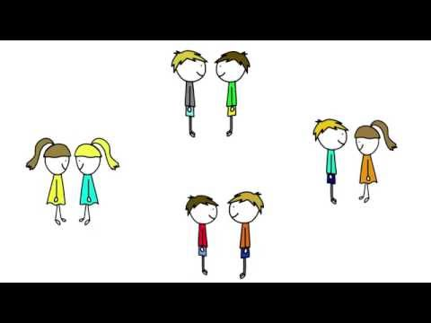

Back-to Back & Face-to-Face Protocol

Slide 11
Reading Informational Text, Craft and Structure
Indicator Code | Skill/Description
RI.9-10.6 | Determine an author's point of view or purpose in a text and analyze how an author uses rhetoric to advance that point of view or purpose.
RI.9-10.5 | Analyze in detail how an author's ideas or claims are developed and refined by particular sentences, paragraphs, or larger portions of a text (e.g., a section or chapter).
RI.11-12.4 | Determine the meaning of words and phrases as they are used in a text, including figurative, connotative, and technical meanings; analyze how an author uses and refines the meaning of a key term or terms over the course of a text.

Slide 12
Writing Editing and Revising
WR.11-12.2d | Use precise language, domain-specific vocabulary, and techniques such as metaphor, simile, and analogy to manage the complexity of the topic.
LA.9-10.1b | Use various types of phrases (noun, verb, adjectival, adverbial, participial, prepositional, absolute) and clauses (independent, dependent; noun, relative, adverbial) to convey specific meanings and add variety and interest to writing or presentations.
LA.7.2a | Use a comma to separate coordinate adjectives (e.g., It was a fascinating, enjoyable movie but not He wore an old[,] green shirt).
LA.7.1b | Choose among simple, compound, complex, and compound-complex sentences to signal differing relationships among ideas.

Slide 13
Activity Debrief
Protocols
  Turn –and – Talk
  Back-to Back & Face-to-Face
Documents
  http://maxinemccormick.com/
    TASC
      TASC CC Achieve 9-12
Notes:
Explain the rational for the use of the documents.
The information was taken from the Gap reports which highlights the areas students need continues practice and exposure to.
Using these document and others from the Gap report we will be engaging in a series of tasks that supports ABE and ESL students at all NRS levels.

Slide 14
Words, Words, Words
Ways to engage students with vocabulary
Notes:
All vocabulary activity will use the words from “HSE Achieve Reading & Writing Vocabulary List”. These are words that have been identifies as key words pertaining to the content that also show up across content, when applicable.
The words can be found at the http://maxinemccormick.com/tasc/tasc-cc-achieve-9-12/
you will work in groups assigned to stations for each vocabulary activity. At the end we will debrief and talk about classroom implication. Let’s begin

Slide 15
Four Principles for
Effective Vocabulary Instruction
Draw attention to all aspects of language: phonology, morphology, syntax, semantics, and pragmatics.
Provide learners with multiple exposures to each word.
Provide many opportunities for contextualized, meaningful practice using all of the language modes.
Foster word-consciousness, or a love of words. (Graves, 2009)
(Nisbet & Tindall, 2015)
Notes:
At COABE I sat in a session that looked at research done by Nisbet & Tindall on effective vocabulary instruction that leads to academic growth in ESL and low level student. Here are 4 principals, as we go through the session looks for evidence of these 4 principals in actions.

Slide 16
Vocabulary Activity
Conceptual Model (Frayer Model)
Concept map
Description/Illustrate
Categorize (compare/contrast,)
Match Pictures with words
Label
Patterns
Words in context
Sentence Frames
Notes:
Have participants engage in different activities around each of the topics:
Fryer Model: use words: (conflict, Equate, compare, depict)

Slide 17
Frayer Model
The Frayer Model is a visual organizer that helps students understand key words and concepts. The Frayer Model is a chart with four sections which can hold a definition, some characteristics/facts, examples and non-examples of the word/concept.
Purpose:
1. identify unfamiliar concepts and vocabulary
2. create visual reference for concepts and vocabulary
Payoff:
Students will:
1. develop understanding of key concepts and vocabulary.
2. draw on prior knowledge to make connections among concepts.
3. compare attributes and examples.
4. think critically to find relationships between concepts and to
develop deeper understanding.
5. make visual connections and personal associations.

Slide 18
Notes:
Assign several words a word from the list Gap analysis word and have participants utilize this tool to engage with the words. Selected words are: comparison, predict, deduce, depict, analyze, conflict Place words in bag

Slide 19
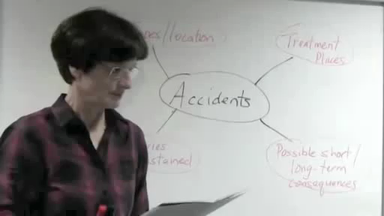
Concept Map
Notes:
At this station you will engage with various maps.
Complete the KWL com= concept chart
Read the text about concept maps.
List two thing you learned about concept maps from the reading
Now view the video, list other things you learned about concept maps?
Now read the text:
Select a concept map of your choice and display the concept, you can work on this as a pairs or individually.

Slide 20
Notes:
At this station you will engage with various maps.
Complete the KWL com= concept chart
Read the text about concept maps.
List two thing you learned about concept maps from the reading
Now view the video, list other things you learned about concept maps?
Now read the text:
Select a concept map of your choice and display the concept, you can work on this as a pairs or individually

Slide 21
Describe It
Use any other words but the word
Draw pictures that describes word

Slide 22
Sticky
Fan
Pick-nick
Barbecue
Hot
Warm Breeze
Lots of bugs
Beach days
Splash in the pool
When you see these words what comes to mind?
Notes:
Read the text. Identify three words that caught your attention. Describe the word using drawings of word. You cannot use the word. Find a partner, take turns drying to figure out what word is being described.. Debrief, what is another way this activity can be done

Slide 23
Categorize It
Definition:
to put (someone or something) into a group of similar people or things
To put (people or things) into categories
Notes:
Have group look at the words and create categories. Use the word chart for this activity

Slide 24
Sentence Frames
I was diplomatic when
____________________.
An example of effective collaboration is
_______________________________.
My co-worker and I had a conflict when we
_____________________________.
Notes:
Copy the sentence from the passage that has the vocabulary word in it.
Use the vocabulary in sentence that relates to the way it was used in the text. Article: Sheriff’s posse goes on school patrol.
Key words: Criminals, Suspicious, Investigation, Critics, Volunteers, Disappointed

Slide 25
Vocabulary Debrief
What are your thoughts about engaging students with vocabulary words through stations?
What would have to happen in order for this to work in your classroom?
Which station can you see yourself trying out in your classroom?
Which station can you see yourself using but you would have make some changes to it base on your learners?
Notes:
Distribute vocabulary list from CTB

Slide 26

Read, Read, Read, Write, Write, Write

Slide 27
Content Depth of Knowledge
(DOK) Framework
Level 1 Recall
  Recall of a fact, information or procedure
Level 2 Skill/Concept
  Use information or conceptual knowledge, two or more steps, etc.
Level 3 Strategic Thinking
  Requires reasoning, developing a plan or sequence of steps, some complexity, more than one possible answer
Level 4 Extended Thinking
  Requires an investigation, time to think and process multiple conditions of the problem or task
Notes:
As students read, we want to poste questions as well as get them to think about and ask question of the text and the author. DOK is a great way to endures that you are varying the kinds of questions you ask students. Varying your questions, models for students what good readers do when they engage with text.
For this part of the day we will be engaging in a variety of ways to engage with text.

Slide 28
DOK Reading & Writing
Year | Level 1 Recall |  | Level 2 Application of Skill/Concept |  | Level 3 Explanation/ Analysis |  | Level 4 Extended Thinking
 | Reading | Writing
 |  |  | Reading | Writing | Reading | Writing | Reading | Writing Essay
2014 | 15% | 20% | 70% | 75% | 15% | 5% | N/A | 100%
2015 | 10-15 % | 15% | 65 - 70% | 70-75% | 20% | 10-15% | N/A | 100%
2016 | 10 % | 10 – 15 % | 65% | 65-70% | 25% | 20% | N/A | 100%
Notes:
This chart shows the kinds of DOK questions asked over the years of CTB TASC test, so it is imperative that we expose our students to various types of questions.

Slide 29

TEA PARTY
Notes:
Voters in Arkansas Tourist Town Uphold Anti-Discrimination Law
By RICHARD FAUSSETMAY 13, 2015

Slide 30
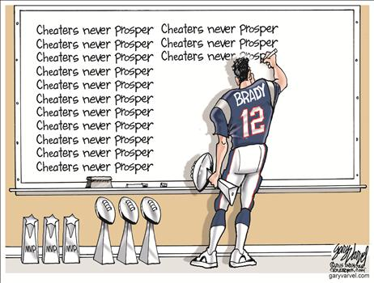
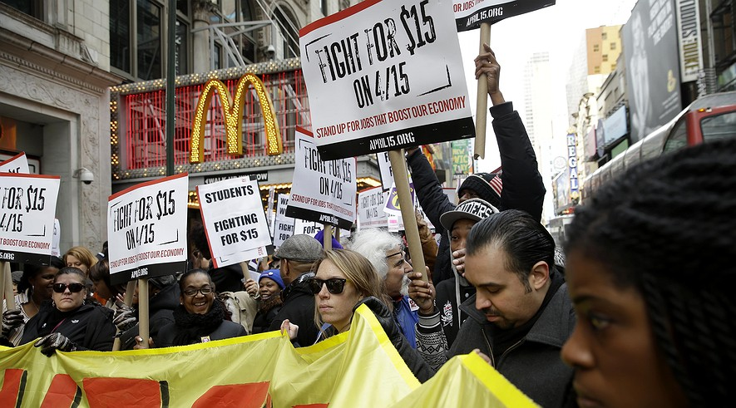

Text
Political Cartoon
Video

Slide 31

What? Who?

Slide 32
For this activity, please:
Type the link into your
web browser bar.
2. Watch the video and complete
the information requested on
the screen.
Type in: Username: rmiller@raennyc.org
password : radult123
http://www.zaption.com/tours/5554e70aa80773454a49c4d2
Notes:
Username: rmiller@raennyc.org
password : radult123

Slide 33





Adult Ed Website
CollectedEDNY.org
Teachingtothecore.org

Slide 34
Resources
http://maxinemccormick.com/
https://www.engageny.org/sites/default/files/resource/attachments/appendix_protocols_and_resources.pdf
https:tolerance.rog/lesson/editorial-cartoon-racial-profiling
https://newsela.com/articles/mcdonalds-wage/id/8437/
https://www.youtube.com/watch?v=LRLkwkG5nPE

