Slide 1
Meeting the Challenge of TASC Mathematics for 2015
Patrick Cravillion
Kathy Lent
Celia Volbrecht

Slide 2
Afternoon Session
Scoot Trig Activity
Trig River
Hypsometer
Blood Spatter

Slide 3
Trig River
Introduction
Is it possible to determine the width of a river without crossing it?
It is possible to come very close to determining
the width of a river of any size, using triangles.
Prediction: Estimate how wide the river is and record your prediction.

Slide 4
Trig River
Pair up with another participant.
Each pair will work from a different tape mark.
Estimate how wide the river is and record it on the back of your worksheet.

Slide 5
Trig River
One student will hold the protractor in place while the other places one end of the string on the center point of the protractor and aims the other end at the Far Edge Marker. Read the angle the string passes over on the protractor and record it on the worksheet
Partners switch jobs and record a second measurement on their worksheet.

Slide 6
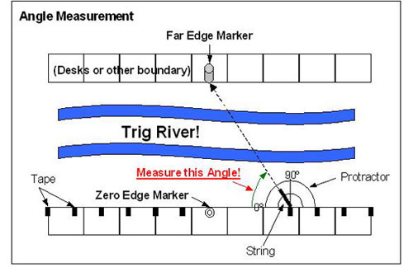
Trig River
Lay the protractor with the center point on the middle of the tape and the zero angle pointing toward the Zero Edge Marker (see Figure above).

Slide 7
Trig River
Questions
Were students closer to the zero marker more or less accurate than those further away?
Could this method be used in the wilderness if you did not have a calculator or Trig Tables?
Notes:
Were students closer to the zero marker more or less accurate than those further away? (Answer: Students close to the zero marker should be less accurate because the values of the tangents of angles close to 90º become large quickly and a small error in the angle measurement results in a large distance error. Note that the same problem would be seen as the measured angle approached zero degrees, but a student would have to be infinitely far away for that.)
Could this method be used in the wilderness if you did not have a calculator or Trig Tables? (Answer: It is not easy to memorize the tangent values for all angles but one value is very easy to remember: tan(45). Have the students find this value and then explain why they get a simple answer.)

Slide 8
How high is it?
Introduction
The same principle used to determine the width of a river can be applied to other situations, including determining the height of a hill, a tree or a building.

Slide 9
How To Make A Clinometer
Materials: Clinometer Protractor, straw, string, staplers, 4" by 6" index card (or cardboard for a more durable product), glue, tape, 1/4” washer or large paper clip.

Slide 10
How To Make A Clinometer
Cut out and tape or glue a protractor scale to the index card or cardboard as shown below. Note that the zero on the protractor should be on the edge of the card.

Slide 11
Tape a straw along the top of the card, as shown. Put the string into the straw at X, pull it through the straw, and staple or tape it to the card near point Y (see diagram).

Slide 12
Tie a weight (such as a washer) to the other end of the string so that the string will hang vertically a little below the bottom of the card. Ensure that the string is long enough for the weight to hang freely throughout the rotation of the clinometer.

Slide 13
Clinometer
When using the clinometer, you should stand at a convenient distance from the object that you are measuring. Sight the top of the object through the straw and record the angle where the string intersects the protractor scale. Your partner can help you with this.
TASK: Find the height of an object in the room or outside.

