Slide 1
Meeting the Challenge of TASC Mathematics for 2015
Patrick Cravillion
Kathy Lent
Celia Volbrecht

Slide 2
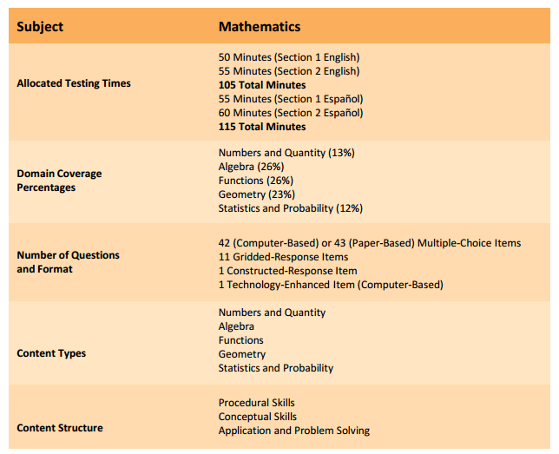
2015 TASC Mathematics Structure

Slide 3
2015 TASC Mathematics
Content Types
Content | Problem Types | Demonstrates | Requires
Number Sense and Operations | Demonstrate an understanding of how quantities change with respect to one another | Evidence of the examinees ability to use units to solve problems | Students need to understand the properties of rational and irrational numbers
Algebra | Multiple choice Gridded response constructed response technology enhanced | Evidence of ability to apply algebraic rules including the distributive property | Students need to isolate a particular quantity of interest
Functions | Multiple choice Gridded response constructed response technology enhanced | Evidence of the ability to analyze and represent constraints by using a system of equations | Students need to analyze graphs to determine distances and areas that depend on the scale and units of measure
Geometry | Multiple choice Gridded response constructed response technology enhanced | Evidence of the ability to recognize and use geometric formulas to compute quantities of interest | Students need to analyze graphs to determine distances and areas that depend on the scale and units of measure
Statistics and Probability |  | Evidence of the ability to determine the subset representing possible outcomes of a question and the subset that describes the event of interest. | Students need to focus selecting the proper subset of the sample space that meets the criteria using quantitative reasoning skills

Slide 4
2015 TASC Mathematics
Content Types
Content | Problem Types | Demonstrates | Requires
Geometry | Multiple choice Gridded response constructed response technology enhanced | Evidence of the ability to recognize and use geometric formulas to compute quantities of interest | Students need to analyze graphs to determine distances and areas that depend on the scale and units of measure

Slide 5
TASC DOK Updates
Year | Level 1 Recall | Level 2 Application of Skill/Concept | Level 3 Explanation/ Analysis | Level 4 Extended Thinking
2014 | 15% | 75% | 10% | Does Not Apply
2015 | 15 – 20 % | 65 - 85% | 10 – 20% | Does Not Apply
2016 | 10 – 20 % | 55 - 75% | 20 – 30 % | Does Not Apply

Slide 6
Greatest Achievement Gap Items
Algebra
Indicator Code | Skills/Description
A-SSE.1.a | Interpret parts of an expression, such as terms, factors, and coefficients.
A-REI.3 | Solve equations and inequalities in one variable. Solve linear equations and inequalities in one variable, including equations with coefficients represented by letters.
A-CED.3 | Create equations that describe numbers or relationship. Represent constraints by equations or inequalities, and by systems of equations and/or inequalities, and interpret solutions as viable or non-viable options in a modeling context. For example, represent inequalities describing nutritional and cost constraints on combinations of different foods.

Slide 7
Greatest Achievement Gap Items
Functions
Indicator | Skills/Description
F-LE.5 | Interpret expressions for functions in terms of the situation they model. Interpret the parameters in a linear or exponential function in terms of a context.
F-IF.4 | Interpret functions that arise in applications in terms of the context. For a function that models a relationship between two quantities, interpret key features of graphs and tables in terms of the quantities, and sketch graphs showing key features given a verbal description of the relationship. Key features include: intercepts; intervals where the function is increasing, decreasing, positive, or negative; relative maximums and minimums; symmetries; end behavior; and periodicity.

Slide 8
Greatest Achievement Gap Items
Number and Quantity
Indicator | Skills/Description
N-Q.3 | Reason quantitatively and use units to solve problems. Choose a level of accuracy appropriate to limitations on measurement when reporting quantities.

Slide 9
Greatest Achievement Gap Items
Statistics and Probability
Indicator | Skills/Description
S-IC.4 | Make inferences and justify conclusions from sample surveys, experiments, and observational studies. Use data from a sample survey to estimate a population mean or proportion; develop a margin of error through the use of simulation models for random sampling.
S-CP.3 | Understand independence and conditional probability and use them to interpret data. Understand the conditional probability of A given B as P(A and B)/P(B), and interpret independence of A and B as saying that the conditional probability of A given B is the same as the probability of A, and the conditional probability of B given A is the same as the probability of B.

Slide 10
Greatest Achievement Gap Items
Geometry
Indicator | Skills/Description
G-MG.2 | Apply geometric concepts in modeling situations. Apply concepts of density based on area and volume in modeling situations (e.g., persons per square mile, BTUs per cubic foot).
G-SRT.5 | Prove theorems involving similarity. Use congruence and similarity criteria for triangles to solve problems and to prove relationships in geometric figures.
G-SRT.8 | Define trigonometric ratios and solve problems involving right triangles. Use trigonometric ratios and the Pythagorean Theorem to solve right triangles in applied problems.

Slide 11
Greatest Achievement Gap Items
Geometry
G-SRT.8 | Define trigonometric ratios and solve problems involving right triangles. Use trigonometric ratios and the Pythagorean Theorem to solve right triangles in applied problems.

Slide 12
Agenda
Introductions
Pythagorean Triangles/Definitions
Pythagoras Activity – Math Interactive
Same Shape Triangles
Trigonometry Activity – Math Interactive
Trig Matching Activity
Scoot – Trig
Look Fors… Teacher/Student

Slide 13
Exploring the Pythagorean Theorem
Math Interactives
This multimedia mathematics resource shows how the Pythagorean Theorem is an important math concept used in the structural design of buildings.
Using an interactive component, students construct right triangles of various sizes to explore calculations of the Pythagorean Theorem. A print activity is provided.

Slide 14
Exploring Trigonometry
Math Interactives
Trigonometry is introduced in this multimedia mathematics resource. A video explains how this math concept is used at airports to ensure the safe landing of airplanes.
Using an interactive component, students explore the use of the trigonometric ratios: sine, cosine, and tangent. A trigonometry print activity is included.

Slide 15
Same Shapes Triangle
What is a ratio?
What happens to the opp/hyp ration
when the angle is large?
What happens to the opp/hyp ratio
when the angle is small?

Slide 16
Same Shapes Triangle
Measure each side of the triangles to the nearest millimeter and record on the Calculating ratios for similar triangles worksheet.
Complete the worksheet for your triangles writing the ratios as a fraction and using a calculator to estimate to 3 decimal places.
Calculate the mean values to 2 decimal places.

Slide 17
Same Shapes Triangle
Plot the mean values on the three class graphs.
What information can you observe from each graph.

Slide 18
Same Shapes Triangle
Triangles which have the same ratios also have the same angles.
This is the basis for scale drawings where although the triangles are different sizes, the angles are in the same proportion.

Slide 19
Same Shapes Triangle
These ratios have a special name.
      Opp/hyp is sine of the angle (sin)
      Opp/Adj is cosine of the angle (cos)
      Opp/Adj is tangent of the angle (tan)
These ratios are used in a branch of mathematics called trigonometry or trig for short.

Slide 20
Trig Match
Triangle | Expression | Answer
T1 | W5 | A1
T2 | W1 | A7
T3 | W11 | A4
T4 | W19 | A14
T5 | W27 | A10
T6 | W2 | A3
T7 | W7 | A5
T8 | W18 | A17
T9 | W29 | A8
Triangle | Expression | Answer
T10 | W9 | A9
T11 | W33 | A6
T12 | W24 | A12
T13 | W31 | A11
T14 | W26 | A15
T15 | W35 | A13
T16 | W22 | A16
T17 | W16 | A18
T18 | W20 | A2

Slide 21
Trig Match
Opposite | Adjacent | Hypotenuse
T2
T3
T8
T10
T15
T17
T4
T6
T12
T14
T16
T18
T1
T5
T7
T9
T11
T13

Slide 22
Trig Match
Sine | Cosine | Tangent
T2
T3
T5
T7
T8
T10
T13
T17
T1
T6
T9
T11
T12
T14
T16
T4
T5
T18

