Slide 1

CCRS
Reading Strategies For
TASC and Beyond

Slide 2




What is a Think Aloud?
It is making your private thoughts about the text public.
Notes:
Explain that A think Aloud is sharing your implicit thoughts around text, explicitly. It is those wheels turning, those electrons firing, its sharing those gaps in your thinking, those questions that are sparked by the text.
Use Explicit Activity Gold/ Brain Text

Slide 3
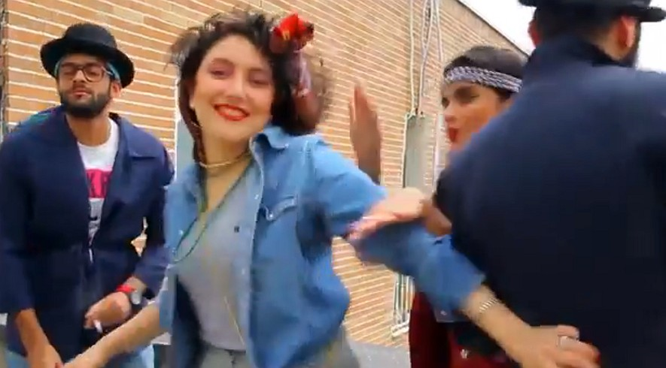
'Happy' video arrests highlight tensions in Iran
In this frame taken from a video posted to YouTube, people dance to Pharrell Williams' hit song "Happy" on a rooftop in Tehran, Iran. Police have arrested six young people and shown them on state television for posting the video. While the song has sparked similar videos all over the world, in Iran some see the trend as promoting the spread of Western culture. Photo: AP
TEHRAN, Iran — An Internet video of six young Iranian men and women dancing to Pharrell Williams' "Happy" has led to their arrests, showing how far Tehran will go to halt what it deems to be decadent Western behavior — despite the views of its moderate president.
Criticism outside Iran was predictably swift Wednesday, with calls for freedom for the jailed youths zipping around social media. Williams tweeted: "It's beyond sad these kids were arrested for trying to spread happiness."
A tweet posted Wednesday evening on President Hassan Rouhani's account seemed to address the controversy, even if it stopped short of mentioning the video or the arrests directly.
"#Happiness is our people's right," it said. "We shouldn't be too hard on behaviors caused by joy."

Slide 4
What Does the Standards Say?
Notes:
Distribute the selected standards. Review the heading and ask the students to read through the standards and think about what this would look like in the classroom.
Have a brief discussion then transition to the explicit instruction model

Slide 5
Explicit Instruction
Notes:
Not to say that anyone there does this, but all lesson should involve explicit instruction. What do I mean by explicit instruction that us aligned to the standards. We will engage in one such explicit instruction, but before we do, lets take a look at the standards. As you look at the standards, let think about what they would look like and sound like in the classroom. Have participants review that standards around reading, writing, listening and speaking. We will engage in explicit instruction, where I will engage in several strategies

Slide 6



How Close Can You Read?
BE
ESL
ESL
BE
ESL
BE
BE
BE
ESL
ESL
ESL
Notes:
Today we will engage in task around close reading. I am going to model for you how to use the skill and then you will have an opportunity to practice using this strategy.

Slide 7
In 1865, just after the American Civil War, a $100,000 gold shipment disappeared in Georgia. Thieves stole two wagon trains filled with gold.
France had loaned the money to the South. The gold was on its way back to France. While soldiers were waiting for their orders, the gold disappeared. No one knows what happened to the gold. Some say the gold was divided among local people. Others say it was buried in a nearby river. Some say it was buried on a local plantation. Soldiers questioned the local people. But the gold was never found. No one was ever seen spending any gold coins. After heavy rainstorms, however, gold coins were often found on dirt roads near the plantation. Some people believe that the treasure is hidden somewhere near the plantation. People still search.
No one has found the gold yet.
Notes:
After the reading ask, what are those moves I made as a teacher

Slide 8
What Moves Did I Make?
Teacher Moves
Model the Gist strategy
Model thinking around arriving at the Gist
Ask questions of students

Slide 9
Notes:
Now it is your turn to take a stab at it

Slide 10
Strategy (3) What’s a Good Title for Me?
Create a title for the article. Use the evidence from:
Your Gist
Shoulder Buddy’s Gist
Group Share
.

Slide 11
What Moves Did Students Make?
Student Moves
Read independently
Worked with peer
Used a note-taking tool to guide the task

Slide 12
Share Out
Notes:
Teacher moves student moves made before during this activity

Slide 13
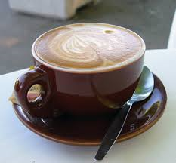
Break

Slide 14
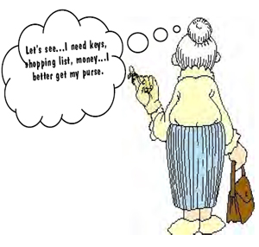
How Do We Chunk Text?
Chunking is the process of breaking-up reading materials into manageable sections.
Notes:
Share research around chunking, explain that sentence can be chunked, paragraph.
Chunk works when students are provided with a focus.
It is a way to begin the process of summarizing. Use paragraphs from Mesopotamia
Present History text and Pictures and assign then into groups with respective tasks 40 min

Slide 15
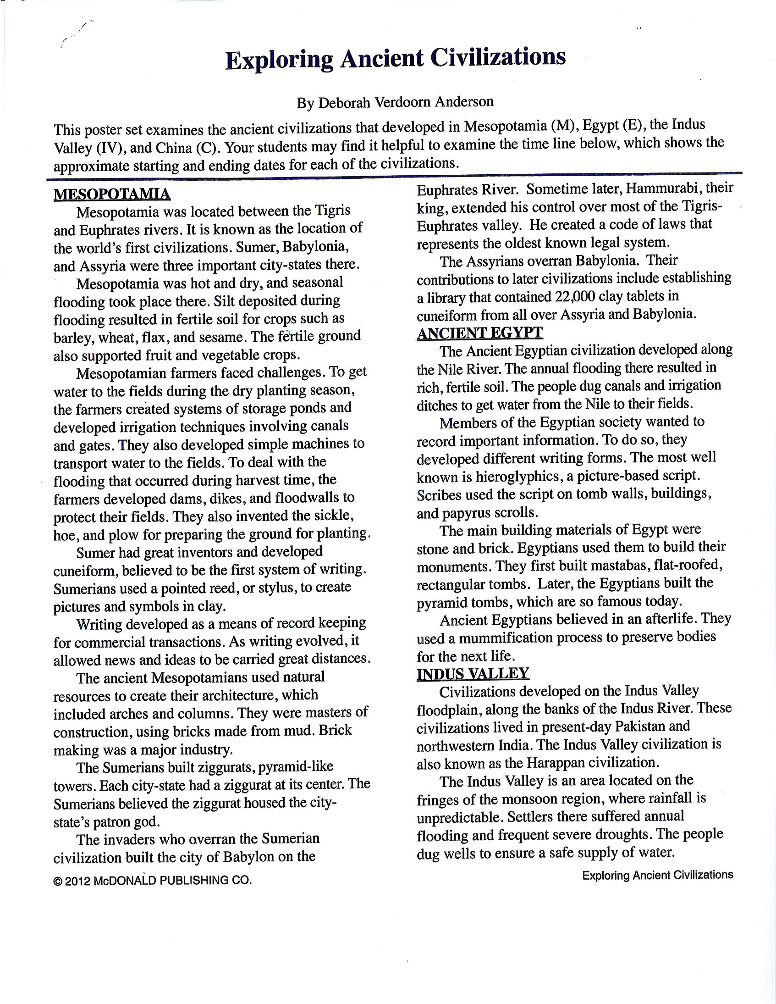
Notes:
Chunking or Jig-Sawing a text

Slide 16

Notes:
How can we How can we get our student to use the skill of paraphrasing in our classroom

Slide 17
Paraphrasing
What is paraphrasing?
  Restating information from the text in your own words
  It’s what they say, NOT what you think
  Its your own words, NOT your own ideas
Why paraphrase?
  To check understanding
  To solidify important points
  To put key information from text into your own words
How can we teach paraphrasing?
Notes:
How can we teach paraphrasing? Listen to participants share, then present sheet, “Quotes and Paraphrase”

Slide 18
Let’s Practice Paraphrasing

Slide 19
Let’s Practice Paraphrasing
Ancient China
Evidence that supports “Ancient China”
Quote or sentence from the text | Key Information | My paraphrase
“China’s geography protected the area from invasion for many centuries. Mountains, deserts, and the Pacific Ocean provided natural barriers. To add to the protection and prevent invasion from the north, the Chinese built the Great Wall of China.” | geography protected the area from invasion Mountains, deserts, and the Pacific Ocean built the Great Wall of China | China was not only protected by the ocean, mountains, and deserts, but they built the Great Wall of China for further security.
Notes:
How can we teach paraphrasing? Have participants suggest ideas.
#1 Present the sheet with the prewritten paraphrases and have participants select the best paraphrase for the excerpt.
Discuss why it is the best
#2 Say this is another approach to teach and continue practicing paraphrasing.
Model by presenting this slide and speaking to select a excerpt from the passage,
#3 Ask participants to select a sentence from the passage and paraphrase it.
Ask how was the process?

Slide 20



Slide 21
What is a Summary
focuses on the main points and leaves out supporting details and facts that add extra length.
Tends to be about one-third the length of the original material.
Gives the main gist of the passage, and conveys the message in a much more concise way, often simplifying it to make it more understandable.

Slide 22

What Can be Included in a Summary?
Who (main Character/s)
What (the problem, dilemma, event….)
Where (location-home, past…. )
When (time, future, present….)
How (did it happen, was it solved….)
Why (did the decision, solution, why did it happen…)
Notes:
Ask, what are something that should be included in a summary? Have participants say, then share this slide

Slide 23
What’s the point of a Summary?
To hits the main points of the text, while being concise
To gives a true sense of what text is all about
To synthesize the big idea
To check the reader’s understanding
To determine important points
To put key information from the text into the reader’s own words

Slide 24
Let’s Practice The Skill Of Summarizing
How can we teach summarizing?
If some students are unable to summarize on their own, start with ….
Notes:
Ask the question: How can we teach Summarizing? Take responses from the audience
Ask, what can be done if some students are unable to summarize on their own? Take responses from the audience then present the next
slide

Slide 25
Start with Ready Made Summaries
Main idea (summary) Detail (specific example) | Which one is it? | How do you know?
Sample: They developed simple machines to transport water. | D | This only gives one piece of information from the text.
Farmers in Egypt invented tools long ago that we use today; the hoe is one such tool. The sickle is another and the plow is another.
To get water to the field farmers invented ponds, water gates and techniques to prevent floods from damaging farm crops. The farmers faced many challenges that they learned how to develop creative ways of solving. Living in Egypt at the time must have been very difficult. In today’s society, we have so many amenities to help farmers, amenities such as mechanical plows and automatic in ground water sprinklers.
To address the many challenges of producing crops, Mesopotamians farmers developed ways of combating seasonal floods, retaining water and tilling the ground. Those inventions were, “storage ponds, canals, gates, floodwalls, sickle and hoes and plows”.
Farmers in Mesopotamian knew how drain excess water from the land by building floodwalls, dams, and water gates. These are samples of irrigation techniques that can assist with the process of farming.
Notes:
Ask all participants to read Paragraph # 2 under Mesopotamia and identify the main idea versus the detail of the passage. After the activity discuss how they would use it in their classroom.
Next present the whole text summary and ask discuss that this could be the next phase. REMINDER: this has to be done more than once.

Slide 26
Mesopotamian farmers faced challenges. To get water to the fields during the dry planting season, the farmers created systems of storage ponds and developed irrigation techniques involving canals and gates. They also developed simple machines to transport water to the fields. To deal with the flooding that occurred during harvest time, the farmers developed dams, dikes, and floodwalls to protect their fields. They also invented the sickle, hoe, and plow for preparing the ground for planting.

Slide 27
Now Try it on Your Own- Summarize
Article Title:____________________________________
Select your Key details | Create your summary
Mesopotamian farmers faced challenges | To address the many challenges of producing crops, Mesopotamians farmers developed ways of combating seasonal floods, retaining water during droughts and prepping the ground for planting. Their inventions ranged from developing storage ponds, canals, gates and floodwalls to inventing sickles, hoes and plows to help make farming somewhat easier.
during the dry planting season,
created systems of storage
irrigation techniques
simple machines to transport water
To deal with the flooding
developed dams, dikes, and floodwalls
invented the sickle, hoe, and plow

Slide 28
Now Try it on Your Own- Summarize
Article Title:_____________________
Select your Key details | Create your summary

Slide 29
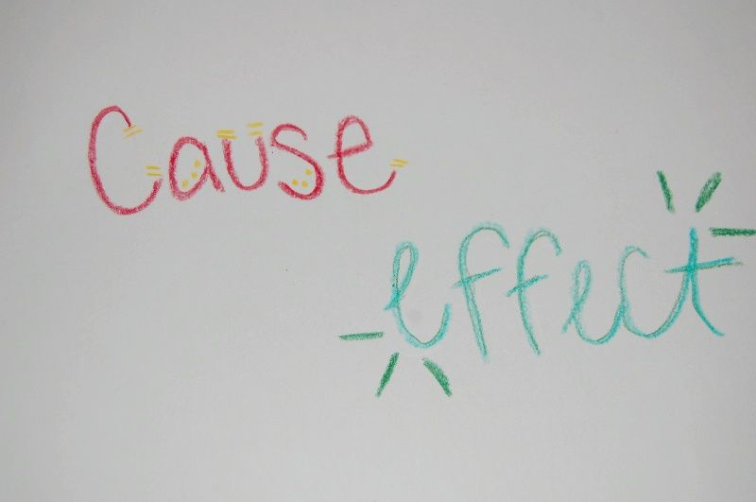

Slide 30
What is Cause/ Effect
Cause:
Effect:
An event or action that happened as a result of another event or action.
It answers the question “what happened?
An event or action that causes something else to happen. “Because” is a clue word that helps identify the cause.
It answers the question “why?”.

Slide 31
Ways to Teach Cause/ Effect
Scavenger Hunt
Examples/Non-examples
Cause & Effect Chain
Use of various Graphic Organizers
Notes:
Share sample organizers that can be used for cause and effect

Slide 32
Wall of Cause and Effect
Cause
  Effect
Notes:
Give out sample document on cause and effect. This shows trhat sometimes the cause comes before the effect or the effect comes before the cause. Use the wall to assign teams to find Cause/Effect throughout the text they can decide how they want to jig-saw the text and decide who will record the cause and who will record the effect.

Slide 33
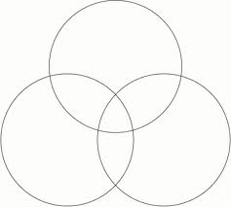
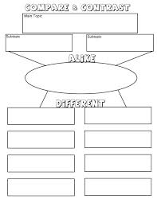
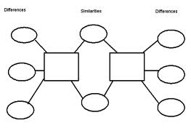
Compare & Contrast
Notes:
Using the Pictures have groups decide which cultures and what within those cultures they will compare/Contrast

Slide 34
Examples of Test Taking Skills
Rereading
Summarizing
Paraphrase
Predict and Confirm
Skip, Read On, and Go Back
Stop and Review (summarize)
Drawing Conclusions
Paraphrase
Cause/Effect relationships
Compare/Contrast
Author’s purpose
Questioning the text
Questioning the author
Context Clues
Process of elimination
Inference
Drawing conclusions
Using Context Clues
Summarizing
Predict and Confirm
Think Aloud
Details

Slide 35
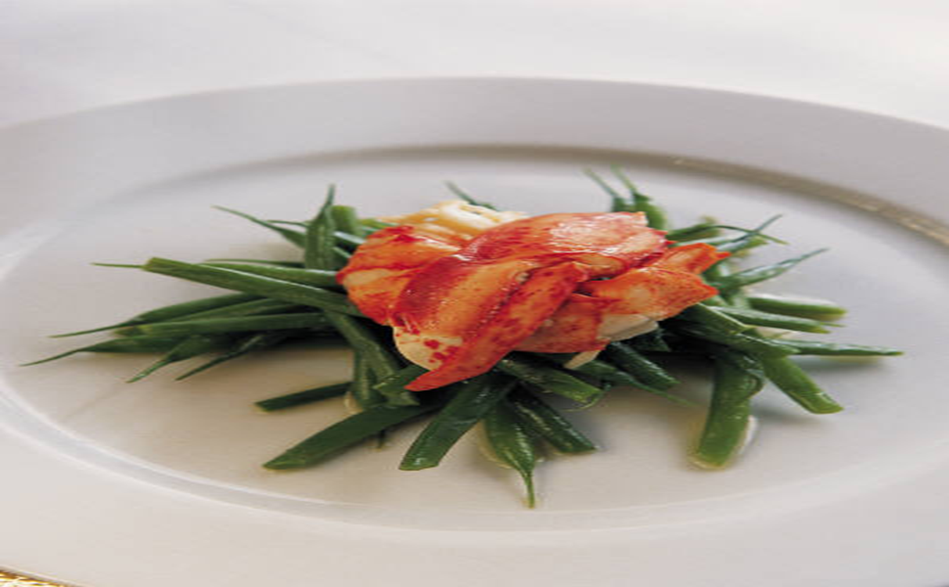

Lunch

Slide 36
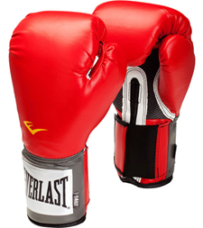

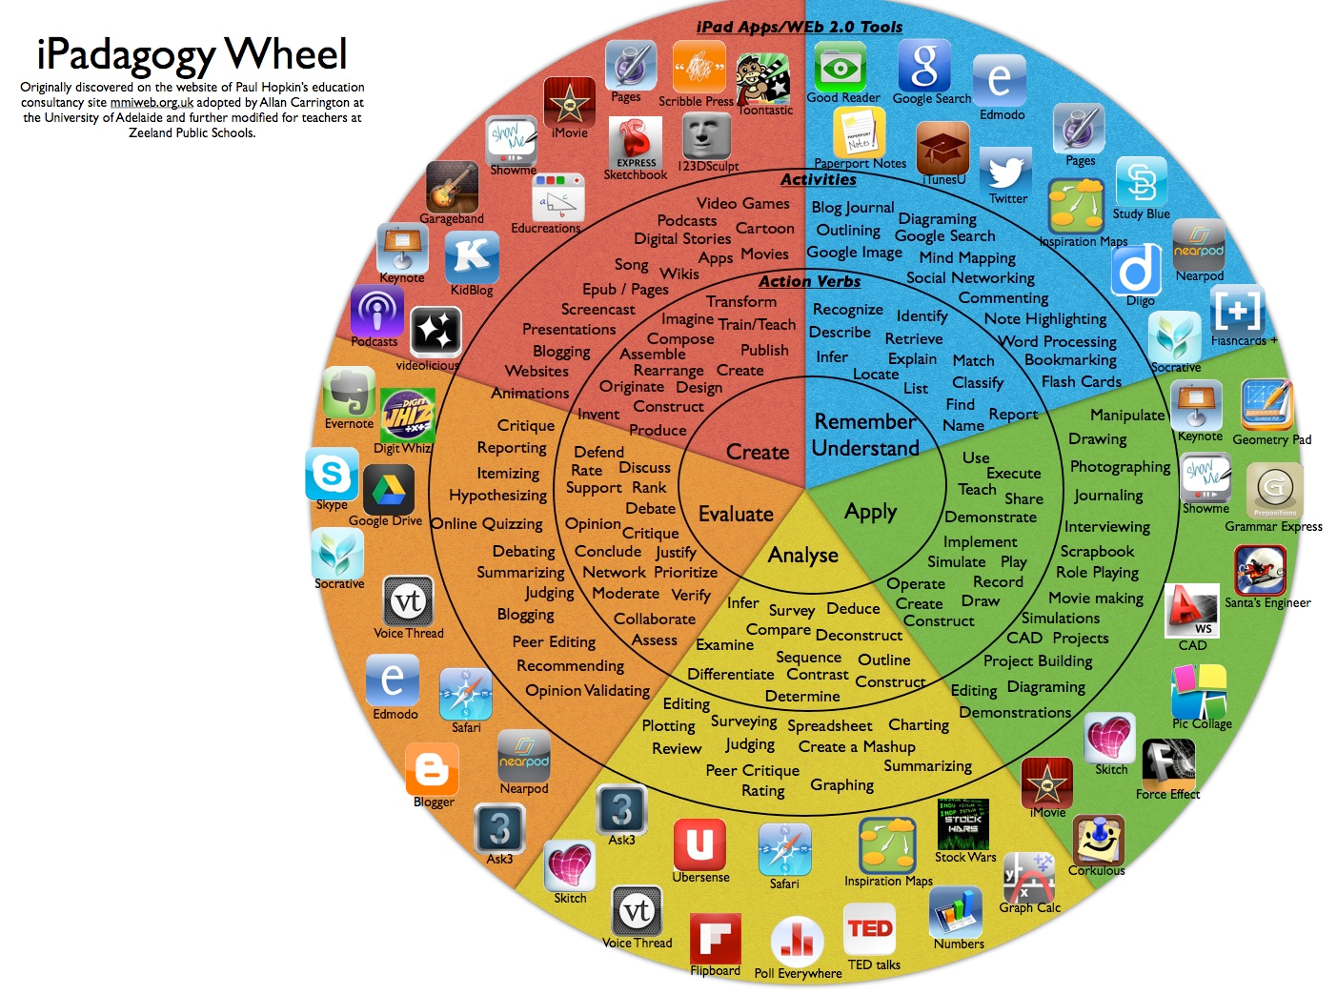
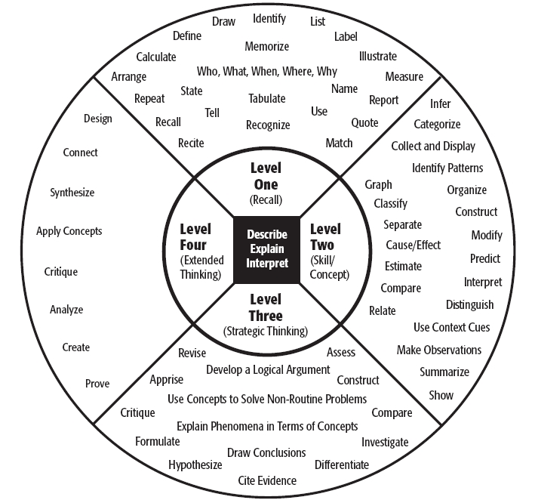
DOK vs. Blooms, What’s the Verdict?
Notes:
Materials:
Chart Paper
Post-It
Writer’s Note book
Markers
Highlighters

Slide 37
Key Shifts in Reading
Shift 1-Complexity
Regular practice with complex text and its academic language
Shift 2 – Evidence
Reading, writing, and speaking grounded in evidence from text, both literary and informational
Shift 3 – Knowledge
Building knowledge through content-rich non-fiction

Slide 38
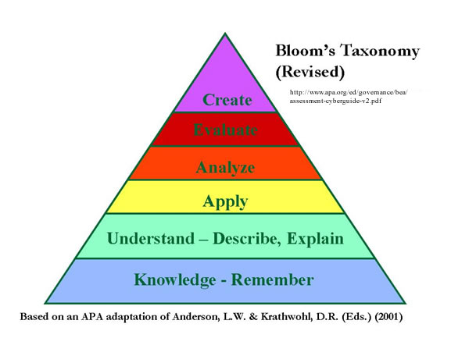
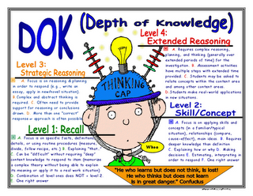
Task
What do we know about Blooms?
What have we learned about Blooms?
What do we know about Webb’s DOK?
What have we learned about Webb’s DOK?
Notes:
Have participants pop out what you know about Blooms and Webb
Have them engage in reading around both
Discuss what did they learn from the reading. Any similarities and differences

Slide 39

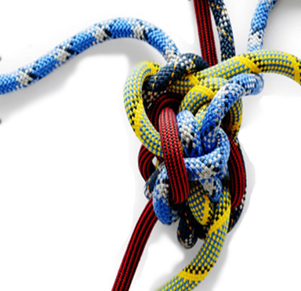
What’s the difference?
Difficult
Complex
Notes:
Popcorn out thinking
Here we have a puzzle and here we have rope intertwine rope – let’s discuss
Present activity:
Have participants place the labels Difficult and Complex on the table: ask them to sort the information based on the title.
Reveal the answers and engage in a discussion
Hess Cognative Rigor for this part
Next, present each group with the additional pictures and ask them to sort all work according to the DOK levels- reaveal the answer and discuss

Slide 40

Difficult or Complex
Name the 50 states in alphabetical order.
Difficult
Using the map on the right, explain two factors that have impacted where state capitals are located.
Complex
Name the 50 states and their capitals in the order they were admitted to the Union.
Difficult

Slide 41
Cognitive Rigor Matrix
Depth + thinking | Level 1 Recall & Reproduction | Level 2 Skills & Concepts/Basic Reasoning | Level 3 Strategic Thinking/ Reasoning | Level 4 Extended Thinking
Remember | Recall, locate basic facts, details, events
Understand | Select appropriate words to use when intended meaning is clearly evident | Specify, explain relationships Summarize Identify main idea | Explain, generalize, or connect ideas using supporting evidence (quote, example) | Explain how concepts or ideas specifically related to other domains or concepts
Apply | Use language structure (pre/suffix) or word relationships (syn/ant) to determine meaning | Use context to identify meaning of word Obtain and interpret information using text features | Use concepts to solve non-routine problems | Devise an approach among many alternative to research a novel problem
Analyze | Identify whether information is contained in a graph, table, etc. | Compare literary elements, terms, facts, events Analyze format, organization, & text structures | Analyze or interpret author’s craft (literary devices, viewpoint, or potential bias) to critique a text | Analyze multiple sources Analyze complex/abstract themes
Evaluate |  |  | Cite evidence and develop a logical argument for conjectures | Evaluate relevancy, accuracy, & completeness of information
Create | Brainstorm ideas about a topic | Generate conjectures based on observations or prior knowledge | Synthesize information within one source or text | Synthesize information across multiple sources or texts
Notes:
The Cognitive Rigor Matrix (a combination of Bloom and Webb developed by Hess et al.) allows us to look at 2 dimensions simultaneously so that we can consider not only what students are asked to do with content, but also the depth with which they need to engage with content to complete an assessment task. A good rule of thumb for determining the DOK level is that 1 & 2 will typically have a right answer; Level 3 is the highest level that state assessments can measure; Level 4 cannot be accomplished within a class period.

Slide 42

The answers are……
Name the 50 states in alphabetical order. Difficult DOK:1
Name the 50 states and their capitals in the order they were admitted to the Union. Difficult DOK:1
Using the map on the right, explain two factors that have
impacted where state capitals are located. Complex DOK 2/3
Explain the function of leaves. DOK: 2
Design an investigation of seedling growth to determine the best fertilizer for this type of tree. DOK: 4
Identify the tree. DOK: 1
Explain how a drought might affect the growth of the tree. DOK:3
Notes:
Have them label each base on their new learning difficult or complex. Identify what DOK level after each reveal the correct response and engage in discussion

Slide 43
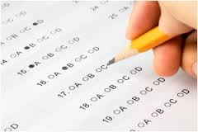
When Do We Employ Test-Taking Skills?
Notes:
Distribute sheet Reading Strategies, give time to read

Slide 44

Wrap-Up/Evaluation
Notes:
Challenge them to engage their students in this type of work, ask them to smart small but start.

