Slide 1
Welcome to the GED® Testing Program!
An Introduction/Refresher to GED® Testing
^{Debi Faucette}

Slide 2
In this session, we will…
Welcome our new community
of New York Adult Educators
to the network of GED®
partners/providers
Discuss the pathways available to support the transition to GED® Testing
Explore the GED® Program
Notes:
Key Points
During this session, we will review the data and share information that has been learned over the last year. We will also review tips and strategies that you can use to help students do that last minute preparation for the test. We will discuss ideas for preparing for the fall when many of your students will be back in the classroom, but still need the added value of technology to supplement their learning.
You’ve done fantastic work this year. It is time for you to celebrate the success that you have had! Join us as we look back at a job well done and forward to new challenges and a new school year, 2021-2022 is closing in fast!

Slide 3
Challenges make you discover things about yourself that you never really knew.
Cicely Tyson
Notes:
We understand that this is a transition—and a challenge--
We also understand our audience—some of you have been in AE since before 2014, and we know you from your work with us and the GED Program in NY prior to 2014
---other of you came to adult education in NY 2014 and later, and have had no experience with the GED® program
Our goal is to speak to ALL Adult educators in NY, regardless of your entry point into Adult Education and support you in your efforts to prepare students to earn the State of NY, and we want to do that by providing you the needed guidance, professional development, yadadda to support you in your success with learners
This is our goal---How will we do this
Ask the question – What did you discover about yourself during this past year of uncertainty, increased need for technology, virtual instruction, etc.?

Slide 4
What We Know About Transitioning from the TASC to the GED for…
NY Adult Education Partners
Some of you were adult educators prior to 2014 and had experience with the GED® Test
Some of you entered adult education at or after 2014 and have no experience with the GED® Test
The level of effort to implement will be overcome by training to be provided by GEDTS
GED Testing Service Partners
Are committed to customer service at the state, regional and local level
will provide training and professional development to successfully prepare students for the test and to establish testing centers
will assist and ease your level of effort to implement the GED® Program

Slide 5
How to Manage the Transition?
Series of Videos
Regional Meetings
Ongoing/Sustained
Professional Development
Notes:
Key Points
All of these resources and more live on the GED Testing Service® website – your primary resource as a GED® trainer.

Slide 6
Online, On-Demand Videos
Welcome to the GED® Program
Understanding
the GED® Test
Preparing Students for the Test
Educators Tools and Resources
The Student Journey

Slide 7
Exploring the Program
Moving to the Future

Slide 8
Helping Adults Prepare for Jobs, Career Training Programs and Higher Education
Help more people start their GED test journey
Help more people finish/pass the GED test
Help more people find a path after passing

Slide 9
An Overview of the GED® Test
Getting Started
Notes:
Key Points
The next few slides provide a quick overview of the GED® test.

Slide 10
^{What’s Different?}
High School Equivalency
TASC™
-5 Sub-tests
Math, SS, Science, Reading, Writing
-Scoring of Writing
--500 points plus 2 of 8 in writing to pass
-Credential depends on passing Writing
GED®
-4 Sub-tests
Math, SS, Science,
Reasoning through Language Arts (RLA)-
Reading and Writing
-Scoring of Writing
--20% of overall RLA Score
-Credential depends on passing RLA

Slide 11
Score scale
Scores range from 100 to 200 on each of the four content modules
Minimum score of 145 per subject in order to pass
Four performance levels:
Below Passing (100 – 144)
Passing (High School Equivalency: 145 +)
GED® College Ready (CCR 165 – 174)
GED® College Ready + Credit (175 - 200)
Standardized and normed on a national sample of high school grads from class of 2013

Slide 12
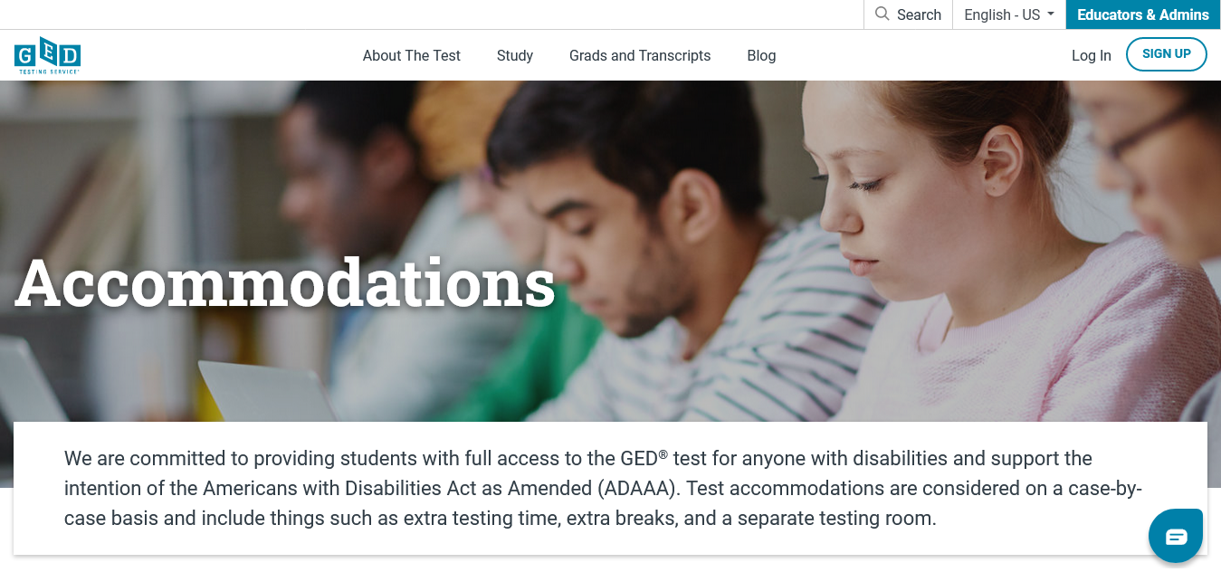
The GED® test
Available in English and Spanish
A wide array of accommodations are available for individuals who have a documented disability. We plan to hold an “All About Accommodations” webinar early 2022.
https://ged.com/about_test/accommodations/

Slide 13
GED® Test
Test | Time | Notes
Reasoning through Language Arts | 150 minutes | Includes 45 minutes for extended response (timed separately) and a 10 minute break
Mathematical Reasoning | 115 minutes | Part 1 – calculator not allowed; Part 2 – calculator allowed
Social Studies | 70 minutes
Science | 90 minutes
Notes:
Key Points
Available in English and Spanish
A wide array of accommodations available
Including zoom-text, alternate color palettes, Braille, screen reader, extended time, paper testing for special circumstances
The chart provides an overview of the time for each of the tests, as well as pertinent notes.

Slide 14
Variety of Item Types
Multiple-choice
Fill-in-the-blank
Drag-and-drop
Hot-spot
Drop-down
Extended-response (Language Arts)
Notes:
The new GED test includes a wider variety of item types than were on the 2002 Series test. Multiple choice items continue to appear on the test as one of the key item types. Multiple choice items are a reliable method of measuring skills and knowledge at a range of cognitive levels in a standardized manner. But remember that the additional item types allow us to measure a wider range of skills and cognitive levels.
Constructed response items come in two versions – one, we call short answer, and that type can be usually be answered in a few sentences (e.g. Science), and the extended response, which requires a longer response – multiple paragraphs (e.g. Reasoning Through Language Arts)

Slide 15
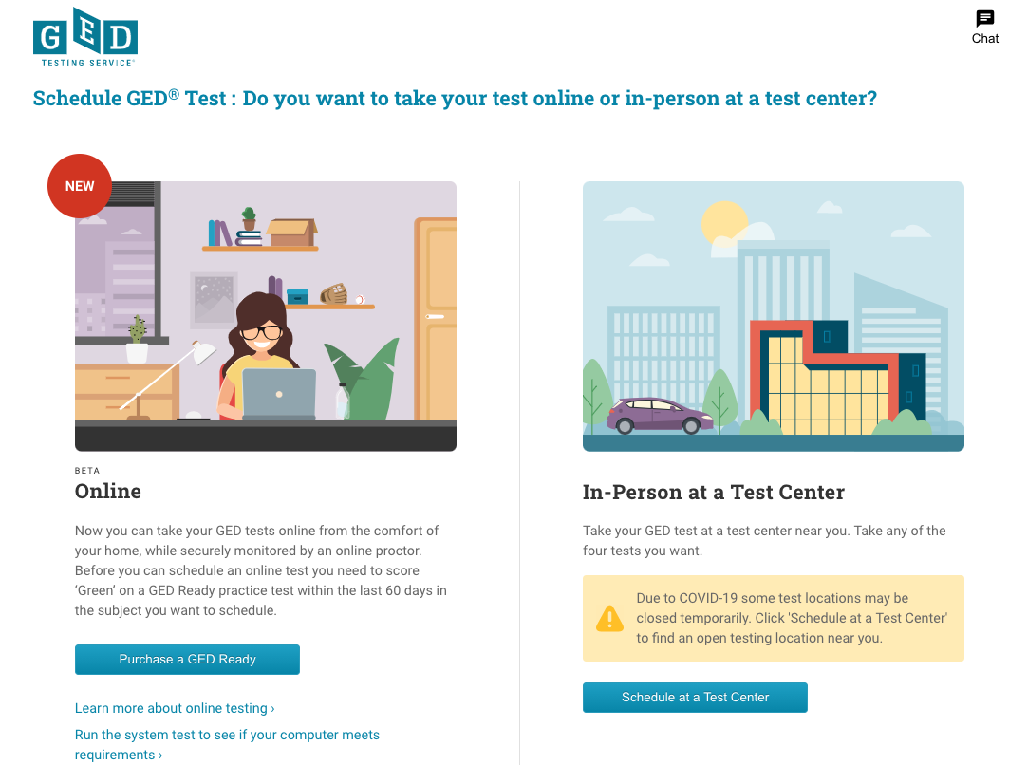
Notes:
After answering scheduling questions they get these two option.
More info on the process is on the website, and resource slides.

Slide 16
Important Tools for the Classroom
Reasoning through Language Arts, Mathematical Reasoning,
Science, and Social Studies

Slide 17
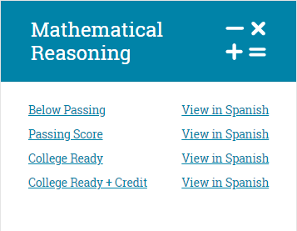
Performance Level Descriptors
Four Performance Levels
Below Passing
HSE
GED® College Ready
GED ® College Ready + Credit
What skills are demonstrated at each level
What skills need development to advance to the next level
https://ged.com/educators_admins/
teaching/teaching_resources/plds/
Notes:
Key Points
Review information on the slide regarding the resource (where it is located and what is included).
PLDs are located at: https://ged.com/educators_admins/teaching/teaching_resources/

Slide 18
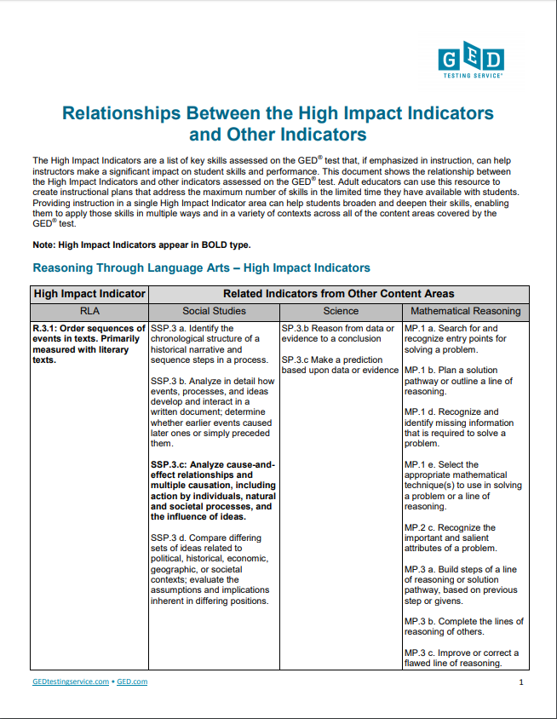
High-Impact Indicators Relationships
Show relationships among High Impact Indicators
Demonstrate interconnectedness across content areas
Develop skills available for use across a range of learning contexts
Notes:
Key Points
Review information on the slide regarding the resource (where it is located and what is included).
Relationships Between the High Impact Indicators and Other Indicators is located at: https://ged.com/wp-content/uploads/relationships_between_HII_and_other_indicators.pdf

Slide 19
GED Ready® : Assessing Readiness
Three Score Level Indicators on GED Ready®
Not Likely to Pass | Too Close to Call | Likely to Pass
100-133 | 134-144 | 145-200
GED Score Report:
^{GED Ready®}
^{GED Exam}

Slide 20
GED® Test Outcomes Research Update
Evidence that GED® Graduates are better prepared for success in college than ever before

Slide 21
American Council on Education (ACE) Recommendations for the GED® Test
GED® College Ready
Score of 165 - 174 on any content test
Waived from developmental education in that content requirements/courses
Waived from placement testing, and
Placed directly in credit-bearing courses
GED® College Ready+Credit
Score of 175 – 200 on any content test
Same as CR recommendations, plus
May provide up to 10 semester hours of college credit
Notes:
Key Points
Review the recommendations from the American Council on Education (ACE).

Slide 22
GED Score Levels Explained

Slide 24
Student & Educator Resources
Notes:
Key Points
The next few slides provide a quick overview of the GED® test.

Slide 25
GED.com for test-takers and educators is full of resources and tools
Resources and Tools for students:
Test tutorial, free practice test, study guide, videos, GED Ready®, score report, study tips, prep products
Career assessment and navigation, GED Works™, GEDPrep Connect
Resources and Tools for educators:
Instructional guides such as our Assessment Guide for Educators and Performance Level Descriptors (PLDs)
Classroom resources such as our RLA Extended Response Scoring Tool, and Math practice and reference sheets
GEDPrep Connect
Professional Development such as our webinar series

Slide 26
Home for GED® Educator Resources
https://ged.com/
Notes:
Key Points
All of these resources and more live on the GED Testing Service® website – your primary resource as a GED® trainer.

Slide 27
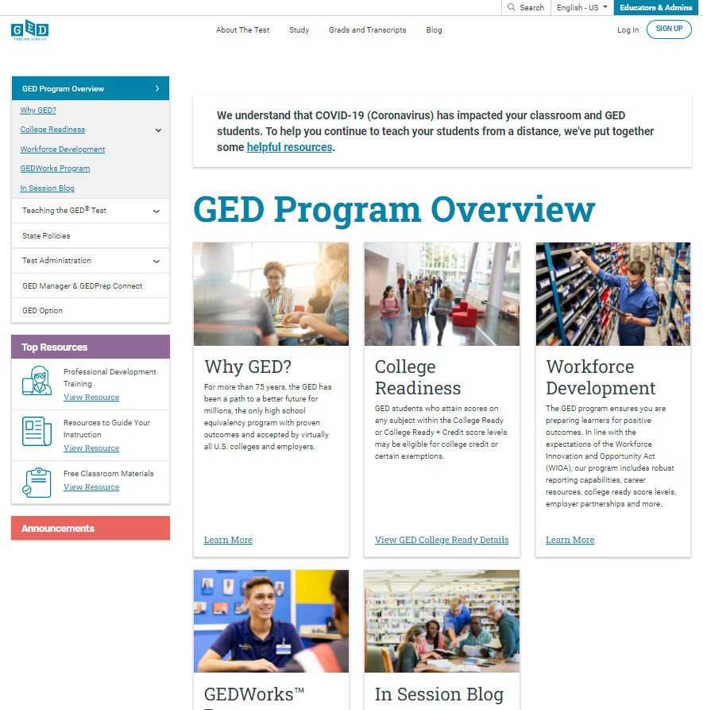

Slide 28
In summary
Website Resources
Printable Resources
And don’t forget…
Human Resources
State Relationship Managers (SRMs)
GEDTS Operations Team
Pearson VUE partners

Slide 29
Thank You!
Let’s stay connected
Communicate with GED Testing Service™:
Scott.salesses@ged.com

