Slide 1
Priority Strategies for FY13/14 Reporting
Rosemary Matt
NYS Director of Accountability
June 2014

Slide 2
Changes to the Program Evaluation Report:

Slide 3
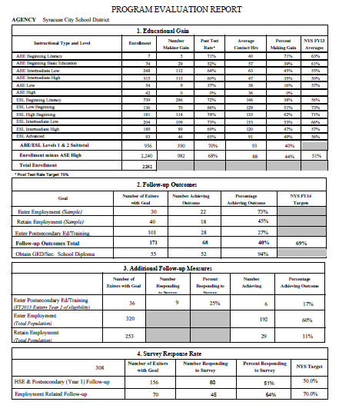

Slide 4
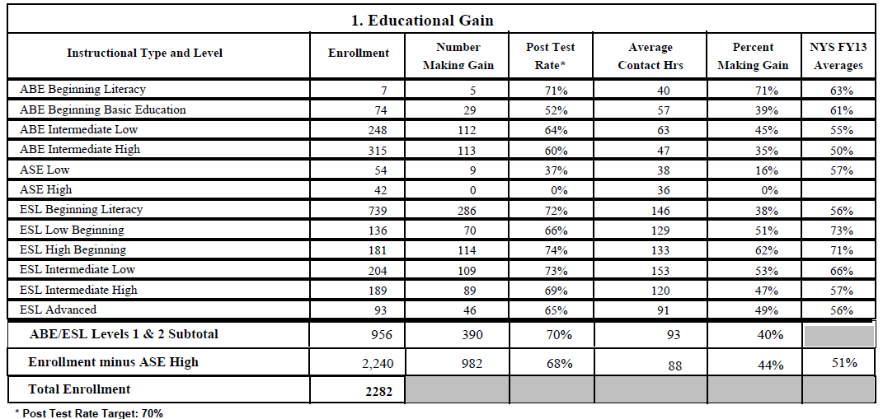
Educational Gain

Slide 5
Follow Up Outcome Table

Slide 6
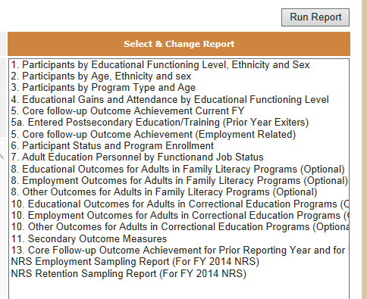
NRS Tables Data Check Reports

Slide 7
Follow Up Outcome Table

Slide 8
NRS Tables Data Check Reports

Slide 9
Additional Follow-Up Measures

Slide 10
NRS Tables Data Check Reports

Slide 11
Additional Follow-Up Measures

Slide 12
NRS Tables Data Check Reports

Slide 13
Response Rate
Employment Outcomes
Entered Employment
Retain Employment
70%

Slide 14
Automatic Goal Setting
Employment
Students who are assigned a 2014 Employment Status of “Unemployed <1 year and Available” or “Unemployed >1 year and Available”
will be assigned the Goal of “Obtain Employment”
Students who are assigned a 2014 Employment Status of “Employed Full-Time” or “Employed Part Time”
will be assigned the Goal of “Retain/Improve Current Job”
NOTE: Employment Goal Setting/changes will appear immediately (after data is saved) on the Goals & Outcomes tab

Slide 15
Outcome Timeline
Employment
Employment: Student may achieve employment anytime while they are enrolled in your program OR by the FIRST QUARTER after exiting

Slide 16
Employment FY13/14
Includes students who have exited in the following Quarters:
Quarters 2, 3, 4 of FY12/13
And
Quarter 1 of FY13/14

Slide 17
EMPLOYMENT Outcomes included in FY13/14 NRS Report range for Exit Dates from October 1, 2012 through September 30, 2013 Quarters 2, 3, and 4 of FY12/13 and Quarter 1 of FY13/14
Employment

Slide 18
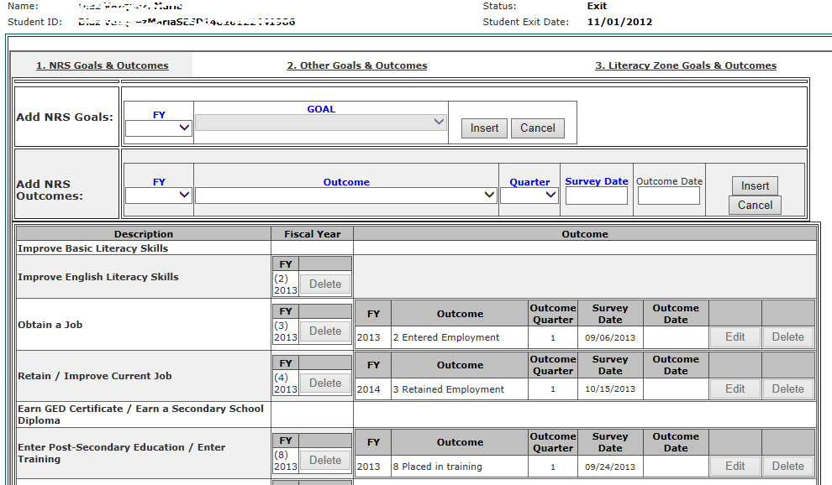
Recording the Outcome in ASISTS

Slide 19
Outcome Timeline
Retain Employment
Retain Employment: Student must retain employment in the THIRD QUARTER after exiting the program

Slide 20
Retain Employment FY13/14
Includes students who have exited in the following Quarters:
Quarter 4 of FY11/12
And
Quarters 1,2, & 3 of FY12/13

Slide 21
RETAIN/IMPROVE EMPLOYMENT Outcomes included in FY13/14 NRS Report range for Exit Dates from April 1, 2012 through March 31, 2013 Quarter 4 of FY11/12 and Quarters 1, 2, and 3 of FY12/13
Retain Employment

Slide 22
Retain Employment

Slide 23
Survey Response Date
Employment
Survey date may be anytime while the student is enrolled or up through October 31st of the reporting year
Retain Employment
Earliest survey date must be within the third quarter after the student’s exit quarter but no later than October 31st of the reporting year

Slide 24
Obtain GED/HSE
Students will be assigned the Goal of “Obtain GED/HSE or HS Diploma” if they meet one or more of the following criteria:
TABE Pre-test into NRS Level 6 ASE High in both Math and Reading
Entry of a GED/TASC test scores
Enrollment in an Instructional Offering with the Instruction Type of “GE-GED”
Enrollment in an Instructional Offering with the Special Program of “EDP Assessment Phase”
NOTE: GED/Secondary School Diploma Goal setting/changes will require an
overnight processing of data

Slide 25
Survey Response Date
Obtain High School Equivalency Diploma
Survey date may be anytime while the student is enrolled or up through October 31st of the reporting year
Reminder: In FY13/14 and FY14/15, this outcome will NOT be included in the NYS Report Card rubric

Slide 26
Enter Postsecondary Education or Training
Students will be assigned the Goal of “Enter Post-Secondary Education or Training” if they meet one or more of the following criteria:
US High School Diploma or Equivalent
Students who have a Secondary School Credential or higher
Foreign country
NOTE: Post-Secondary Education/Training Goal setting/changes will require an overnight processing of data to appear on the Goals & Outcomes tab

Slide 27
Survey Response Date
Enter Postsecondary Education or Training
Survey date must be after the student exits but no later than October 31st of the reporting year
Or in the case of a foreign diploma, survey date may be while they are in the program
Beginning with FY13/14, students with this goal that do not achieve in the year in which they exited will have the next program year to achieve the outcome

Slide 28
New Information:
Students’ Highest Educational Level or Degree Attained
&
Teacher Experience and Certification
These fields are already available in ASISTS
they are REQUIRED fields

