Slide 1
Mathematics Institute
Central Southern Tier RAEN
December 4, 2013

Slide 2
Preparing Yourself & Your Students for the TASC
Don’t try to reinvent the wheel
    Use existing resources whenever possible
Be prepared to allow students to approach mathematics in unconventional ways
Begin conversations with your students helping them understand there may be several ways to solve math problems
You will always demonstrate at least one way
    They may choose a different process
    However, they must be able to explain their approach

Slide 3
Preparing Your Classroom
Are you able to utilize multi-media in your classroom?
Bear in mind that in adult education, each student may be working on a different level of math
What technology is available to your students?
  Video demonstrations (it doesn’t always need to be you teaching a lesson)
  LCD projector for the use of PowerPoint presentations (again, not necessarily only those you create)
  Online resources which would require student level access to the internet

Slide 4
Most Effective Transition to Teaching Math in AE
Teachers will not have the time to learn all math concepts and then try to teach them to their students
Incredible amount of great teaching tools on the internet
Varies the teaching modalities for your students
Better approach to Common Core
Allows your students to learn from different resources
Eliminates the extreme burden for teachers in the next 3 years as TASC ramps up to full CC integration

Slide 5
The Common Core:
Six Instructional Shifts for Math
Focus
Coherence
Fluency
Deep Understanding
Applications
Dual Intensity

Slide 6
What is a Mathematical Problem?
Kate bought some roses to make some money for a gift she wanted to buy. She paid $6.00 for every 12 roses she bought. Later, Kate was charging $6.00 for 8 of them. She sold them all and made a profit of $12.00. How many roses did Kate buy and sell?

Slide 7
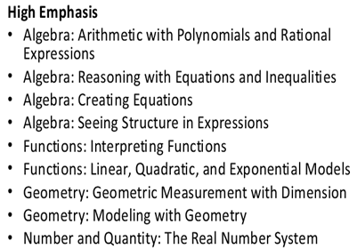
TASC Mathematics

Slide 8
TASC Mathematics
Test Proportions
Number and Quantity 15%
Algebra 25%
Functions 25%
Geometry 25%
Statistics and Probability 10%

Slide 9
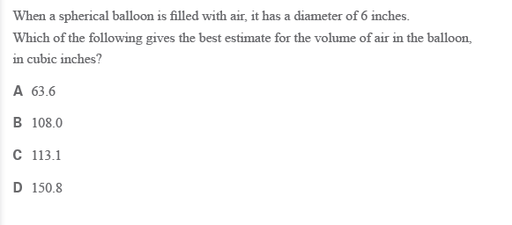
TASC Sample Question #1

Slide 10
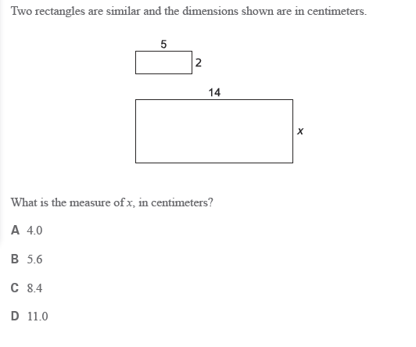
TASC Sample Question #2

Slide 11
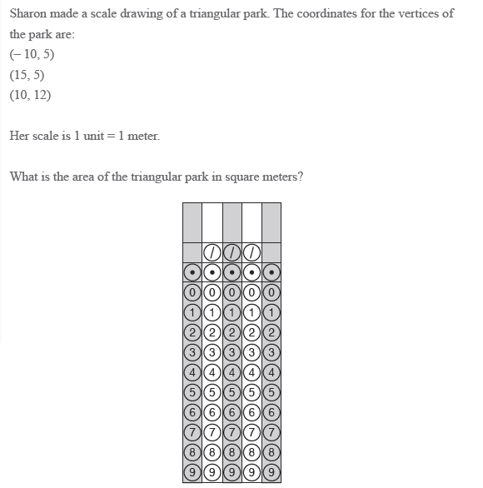

Slide 12
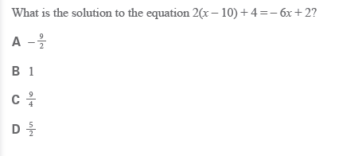
TASC Sample Question #4

Slide 13
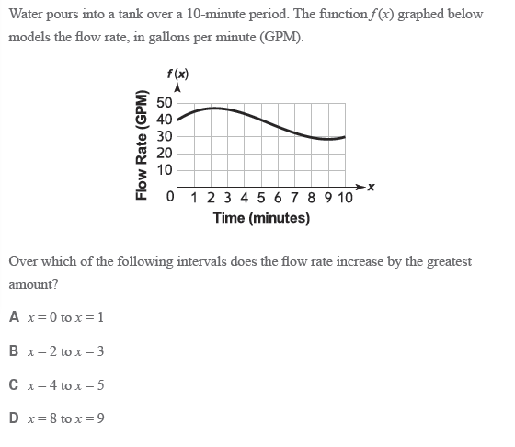
TASC Sample Question #5

Slide 14
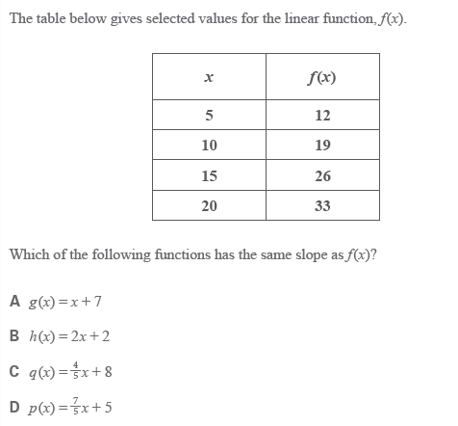
TASC Sample Question #6

Slide 15
Solving Linear Equations
http://www.youtube.com/watch?v=mxBoni8N70Y
http://www.khanacademy.org/math/algebra/solving-linear-equations-and-inequalities/old-school-equations/v/algebra--linear-equations-4
http://www.sosmath.com/algebra/solve/solve0/solve0.html

Slide 16
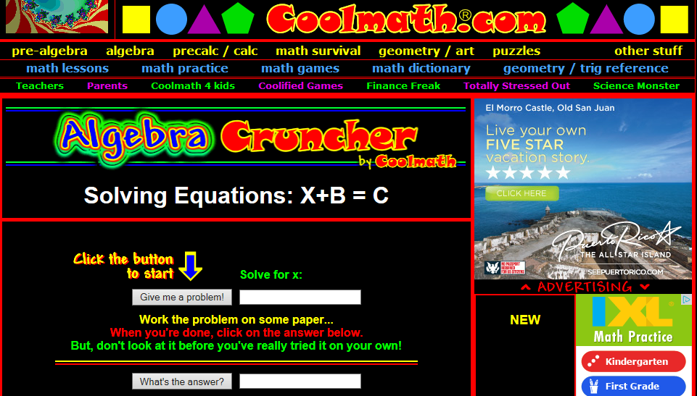
Not So Good Website
http://www.coolmath.com/crunchers/algebra-problems-solving-equations-1.htm

Slide 17
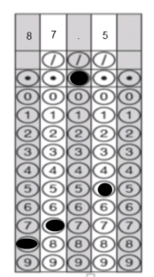
Answer Key
What is a Mathematical Problem?
Kate bought and sold 48 roses.
TASC Sample Questions
#1 C
#2 B
#3 87.5m²
#4 C
#5 A
#6 D

