Slide 1
Central Southern RAEN Syracuse December 9, 2014
Patrick Cravillion
Pavel Zomb
New York City Department of Education
Office of Adult and Continuing Education

Slide 2
Van hiele Model
Levels of thinking in Geometry

Slide 3
Levels of Thinking in Geometry
Visual Level
Descriptive Level
Relational Level
Deductive Level
Rigor
Notes:
The development of geometric ideas progresses through a hierarchy of levels. The research of Pierre van Hiele and his wife, Dina van Hiele-Geldof, clearly shows that students first learn to recognize whole shapes then to analyze the properties of a shape. Later they see relationships between the shapes and make simple deductions. Only after these levels have been attained can they create deductive proofs.

Slide 4
Van Hiele Model
Level 1: Visual level
Students at this level recognize figures by their appearance. For example they may say that the shape on the left below is a square and the shape on the right is a diamond ...."because it looks like a....”

Slide 5
Van Hiele Model
Level 2: Descriptive/Analytic
Students at this level recognize/analyze figures by their properties or components. For example, students will describe figures below as squares because they both have 4 sides, 4 right angles, opposite sides equal....and as many other properties as they know about squares.

Slide 6
Van Hiele Model
Level 3: Abstract / Relational
Students at this level can distinguish between necessary and sufficient conditions for a concept; they can also form abstract definitions, and classify figures by elaborating on their interrelationships. For example, a student at this level may define a square as a rectangle with consecutive sides congruent

Slide 7
Van Hiele Model
Level 4: Formal Deduction
Students establish theorems within an axiomatic system. They recognize the difference between undefined terms, definitions, axioms, and theorems. They are capable of constructing original proofs.
Level 5: Mathematical Rigor
Students understand the relationship between various systems of geometry. They are able to describe the effect of adding or deleting an axiom on a given geometric system. These students can compare, analyze, and create proofs under different geometric systems.

Slide 8
Visual Level Characteristics
The student
identifies, compares and sorts shapes on the basis of their appearance as a whole.
solves problems using general properties and techniques (e.g., overlaying, measuring).
uses informal language.
does NOT analyze in terms of components.
Notes:
Language at the Visual Level serves to make possible communication for the whole group about the structures that students observe. The vocabulary representing the figures helps in describing the figures. Any misconceptions identified may be clarified by the use of appropriate language. The language of the next level, e.g., congruence, will not be understood by students who are at the Visual Level.

Slide 9
Descriptive Level Characteristics
The student
recognizes and describes a shape (e.g., parallelogram) in terms of its properties.
discovers properties experimentally by observing, measuring, drawing and modeling.
uses formal language and symbols.
does NOT use sufficient definitions. Lists many properties.
does NOT see a need for proof of generalizations discovered empirically (inductively).
Notes:
The language of the Descriptive Level includes words relating to properties within a given figure, e.g., parallel, perpendicular, and congruent. Various properties can be used to describe or define a figure, but this is usually a very uneconomical list of properties. A concise definition, using a sufficient number of properties rather than an exhaustive list, is not possible at this level. Students functioning at the Visual Level are not able to understand the properties of the Descriptive Level even with the help of pictures.

Slide 10
Relational Level Characteristics
The student
can define a figure using minimum (sufficient) sets of properties.
gives informal arguments, and discovers new properties by deduction.
follows and can supply parts of a deductive argument.
does NOT grasp the meaning of an axiomatic system, or see the interrelationships between networks of theorems.
Notes:
The language of the Relational Level is based on ordering arguments which may have their origins at the Descriptive Level. For example, a figure may be described by an exhaustive list of properties at the Descriptive Level. At the Relational Level it is possible to select one or two properties of the figure to determine whether these are sufficient to define the figure. The language is more abstract with its causal, logical and other relations of the structure. A student at the Relational Level is able to determine relationships among figures, and to arrange arguments in an order in which each statement except the first one is the outcome of previous statements.

Slide 11
Deductive Level Characteristics
The student
recognizes and flexibly uses the components of an axiomatic system (undefined terms, definitions, postulates, theorems).
creates, compares, contrasts different proofs.
does NOT compare axiomatic systems.
Notes:
The Deductive Level is sometimes called the Axiomatic Level. The language of this level uses the symbols and sequence of formal logic.

Slide 12
Rigor
The student
compares axiomatic systems (e.g., Euclidean and non-Euclidean geometries).
rigorously establishes theorems in different axiomatic systems in the absence of reference models.
Notes:
The student is able to establish proofs and reach conclusions using the symbolic language of the system without the aid of visual cues.

Slide 13
Is the development of geometric understanding related to age or maturation? experience? instruction?
A. Progress from one level to the next level is more dependent on educational experiences than on age or maturation. Some experiences can facilitate (or impede) progress within a level or to a higher level.

Slide 14
Can a student skip levels?
A. According to the van Hieles’model, a student cannot achieve one level of understanding without having mastered all the previous levels. Research in the United States and other countries supports this view with one exception. Some mathematically talented students appear to skip levels, perhaps because they develop logical reasoning skills in ways other than through geometry.

Slide 15
What if the teacher is thinking at a different van Hiele level than the students?
A. This situation is common. Most high school geometry teachers think at the fourth or fifth van Hiele level. Research indicates that most students starting a high school geometry course think at the first or second level. The teacher needs to remember that although the teacher and the student may both use the same word, they may interpret it quite differently.
For example, if a student is at the first level, the word “square” brings to mind a shape that looks like a square, but little else. At the second level, the student thinks in terms of the properties of a square, but may not know which ones are necessary or sufficient to determine a square.

Slide 16
agenda
Combining Rectangles (1 hour)
Problem Solving Strategies (½ hour)
Central Angles, Inscribed angles, and Intercepted Arcs (1 ½ hours)
LUNCH
Filling the Room (1 hour)
Problem Solving Strategies with volume (½ hour)
Trigonometry/ Clinometer (1 ½ hours)

Slide 17
Combining Rectangles Over, Around, and Within Geometry and Measurement
EMPowerTM
extending mathematical power

Slide 18
Objectives (Combining Rectangles)
Calculate area of a rectangle using square centimeters
Articulate what happens to area and perimeter when rectangles are combined
Find the area of any shape composed of multiple rectangles

Slide 19
Combining Rectangles
You cannot measure area with a ruler because rulers measure length in lines. Area is measured in square units. How many square centimeters (sq. cm) are inside this shape?
1
2
3
4
5
6
7
8
9
10
11
12
13
14
15
16
17
18
19
20
21
22
23
24
25

Slide 20
Drawing Four Rectangles
Draw a 5 cm × 10 cm rectangle on square-centimeter grid paper. Label it “Rectangle 1.”
Note: Label inside the rectangle.
a
Draw three more rectangles of different dimensions on grid paper. Label them “Rectangles 2, 3, and 4.”
Note: Label inside the rectangles.

Slide 21
Drawing Four Rectangles
Record the measurements in the table below. Use cm for length, width, and perimeter measures and sq. cm for area.
 | Length (l) in cm | Width (w) in cm | Area (A) in sq. cm | Perimeter (P) in cm
Rectangle 1
Rectangle 2
Rectangle 3
Rectangle 4
All rectangles combined

Slide 22
Area & perimeter problem
Problem
Solving Strategies
Liz said that she would take Jill to lunch if she could find the only two rectangles whose dimensions are integers and whose area and perimeter equal the same number. What should Jill's answer be?
Look for a pattern
Construct a table
Make an organized list
Act it out.
Draw a picture.
Use objects
Guess and Check
Work backwards
Write an equation
Solve a simpler (or similar problem
Make a model

Slide 23
Central Angles, Inscribed angles, and Intercepted Arcs Objectives:
Calculate the measurements of central angles and inscribed angles using a compass and protractor.
Discover the relationships between central angles, inscribed angles, and angle measures of the intercepted arc.

Slide 24
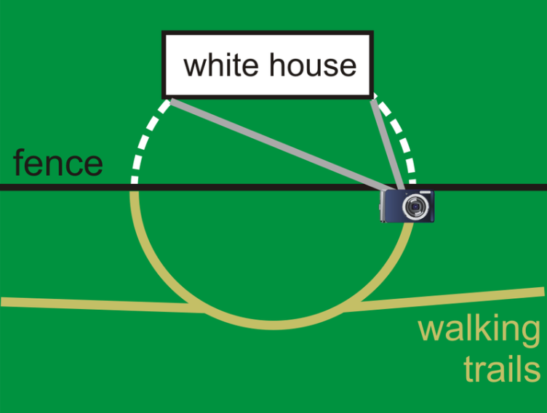
Inscribed Angles in Circles
Imagine you went to Washington DC and saw the White House. The closest you can get to the White House are the walking trails on the far right. You got as close as you could (on the trail) to the fence to take a picture (you were not allowed to walk on the grass).

Slide 25
Where else could you have taken your picture from to get the same frame of the White House? Where do you think the best place to stand would be? – We will come back to this!
Your line of sight in the camera is marked in the picture as the grey lines. The white dotted arcs do not actually exist, but were added to help with this problem.

Slide 26
What are the parts of a circle?
To answer our questions, we will need to know more about circles. Draw a circle and label all the different parts of a circle that you know.

Slide 27
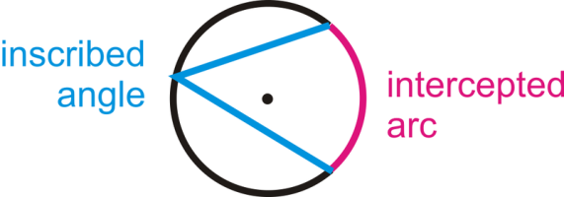
Some terminology before we begin….
An inscribed angle is an angle with its vertex on the circle and whose sides are chords. The intercepted arc is the arc that is inside the inscribed angle and whose endpoints are on the angle. The vertex of an inscribed angle can be anywhere on the circle as long as its sides intersect the circle to form an intercepted arc.
OK let’s begin!

Slide 28
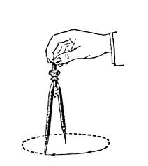
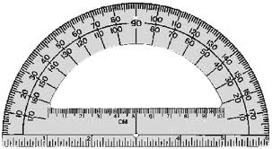
Which one’s the compass?!

Slide 29
Lets practice drawing a circle
Using the compass, lets make a circle.
1st mark the point in the center of the circle and give it a letter, O.
2nd Draw a line through the center and the circle.
Now that we have a diameter, lets draw a 90 degree central angle. Give yourself a lot of space of on your papers.
Think about this: How many degrees are in a circle? If we divide the circle into four parts, what will the degree measure of each intercepted arc be? Will the degree measure be different if the size of the circle changes?

Slide 30
Investigation: Measuring an Inscribed Angle: Circle a
Draw an inscribed angle in circle A and make one side of the inscribed angle a diameter
Next, using your ruler, draw in the corresponding central angle and label the endpoints.
Using your protractor measure the inscribed angle and the central angle you created and determine if there is a relationship between the central angle and the inscribed angle.
Make sure your lines are long enough to be measured with the protractor!

Slide 31
Investigation: Measuring an Inscribed Angle: Circle b
Draw another inscribed angle in circle B and make point B inside the inscribed angle.
Using your ruler, draw in the corresponding central angle and label the endpoints.
Using your protractor, measure the inscribed angle and the central angle you created and determine if there is a relationship between the central angle and the inscribed angle.
Make sure your lines are long enough to be measured with the protractor!

Slide 32
Investigation: Measuring an Inscribed Angle: Circle c
For circle C, draw an inscribed angle and make point C outside the inscribed angle.
Using your ruler, draw in the corresponding central angle and label the endpoints.
Using your protractor, measure the inscribed angle and the central angle you created and determine if there is a relationship between the central angle and the inscribed angle.
Make sure your lines are long enough to be measured with the protractor!

Slide 33
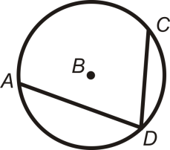
Inscribed Angle Theorem
The Inscribed Angle Theorem states that the measure of an inscribed angle is half the measure of its intercepted arc.

Slide 34
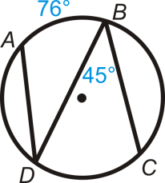
Time for some math! Example A:
Find and m<ADB.

Slide 35
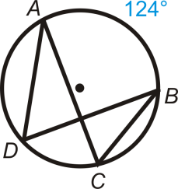
Example B:
Find m<ADB and m<ACB .
m<ADB =
m<ACB =
What can we say about the two inscribed angles?

Slide 36
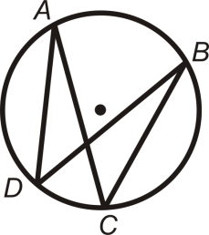
Congruent Inscribed Angles Theorem
Inscribed angles that intercept the same arc are congruent. This is called the Congruent Inscribed Angles Theorem and is shown below.
<ADB and <ACB intercept arc AB, so m<ADB = m<ACB. Similarly, <DAC and <DBC intercept arc DC, so m<DAC = m<DBC.

Slide 37
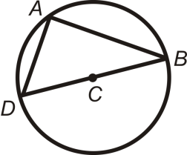
Example C:
Find m<DAB in .

Slide 38
SEMICIRCLE THEOREM
An angle intercepts a semicircle if and only if it is a right angle. Anytime a right angle is inscribed in a circle, the endpoints of the angle are the endpoints of a diameter and the diameter is the hypotenuse.
<DAB intercepts a semicircle, so m<DAB = 90 degrees. <DAB is a right angle, so arc DB is a semicircle.

Slide 39
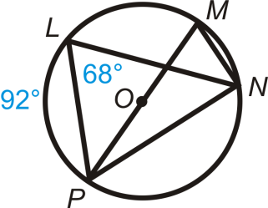
More Guided Practice
1.
Find :
1. m<PMN=
2. m Arc PN=
3. m<MNP=
4. m<LNP=

Slide 40
More Guided Practice
1.
Find :
1. m<PMN= 68
2. m Arc PN= 136
3. m<MNP= 90
4. m<LNP= 46

Slide 41
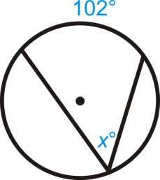
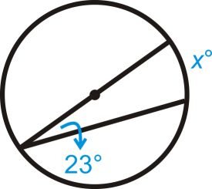
2.
3
X =
X =

Slide 42
2.
3
X = 51
X = 46

Slide 43
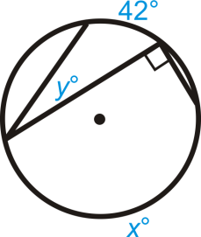
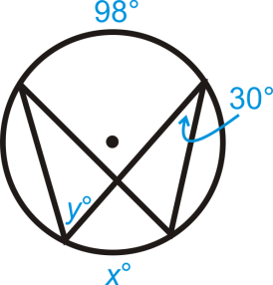
4.
5
X =
Y =
X =
Y =

Slide 44
4.
5
X = 180
Y = 21
X = 60
Y = 49

Slide 45
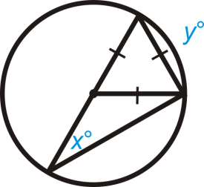
The Challenge!
6.
X =
Y =

Slide 46
The Challenge!
6.
X = 30
Y = 60

Slide 47
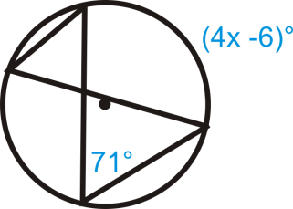
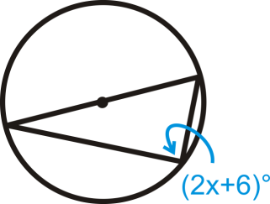
Solve for X
7.
8.
X =
X =

Slide 48
Solve for X
7.
8.
X = 37
X = 42

Slide 49
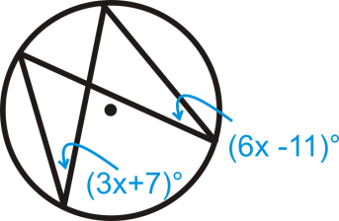
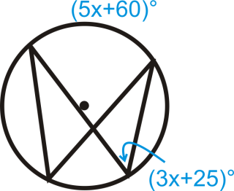
Solve for X
9.
10.
9. X =
10. X =

Slide 50
Solve for X
9.
10.
9. x = 6
10. x = 10

Slide 51
Check up!
1. True or False: An inscribed angle is an angle with its vertex on the circle and whose sides are chords.
2. True or False: The intercepted arc is the arc that is inside the inscribed angle and whose endpoints are on the angle.

Slide 52
Check up!
1. True or False: An inscribed angle is an angle with its vertex on the circle and whose sides are chords. TRUE
2. True or False: The intercepted arc is the arc that is inside the inscribed angle and whose endpoints are on the angle. TRUE

Slide 53
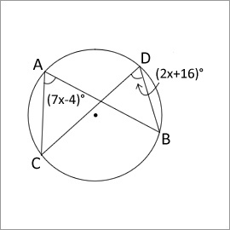
3. In the given figure what is the measure of arc BC.
A) 24 degrees
B) 48 degrees
C) 90 degrees
D) none of the above

Slide 54
3. In the given figure what is the measure of arc BC.
Answer:
B) 48 degrees

Slide 55
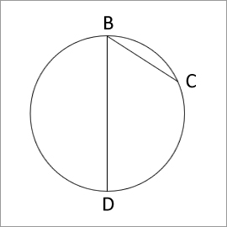
4. Anytime a right angle is inscribed in a circle, the endpoints of the angle are the endpoints of a diameter and the diameter is the hypotenuse.
5. Given that line segment BD is a diameter of the circle, what must be true about arc CD?
A) It is exactly 90 degrees
B) It is exactly 180 degrees
C) It is between 0 and 180 degrees
D) It is between 180 and 360 degrees

Slide 56
4. Anytime a right angle is inscribed in a circle, the endpoints of the angle are the endpoints of a diameter and the diameter is the hypotenuse.
TRUE
5. Given that line segment BD is a diameter of the circle, what must be true about arc CD?
Answer:
C) It is between 0 and 180 degrees

Slide 57
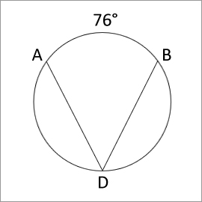
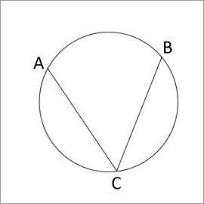
6. In the given figure find the measure of the angle ADB.
A) 38 degrees
B) 76 degrees
C) 114 degrees
D) none of the above
7. True or False: Angle ACB is the inscribed angle.

Slide 58
6. In the given figure find the measure of the angle ADB.
Answer:
A) 38 degrees
7. True or False: Angle ACB is the inscribed angle. TRUE

Slide 59
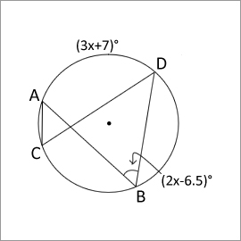
8. Find the measure of angle ACD in the given figure.
A) 67 degrees
B) 42.8 degrees
C) 33.5 degrees
D) 20 degrees
9. True or False: Inscribed angles that intercept the same arc are non-congruent.

Slide 60
8. Find the measure of angle ACD in the given figure.
Answer:
C) 33.5 degrees
9. True or False: Inscribed angles that intercept the same arc are non-congruent. FALSE

Slide 61
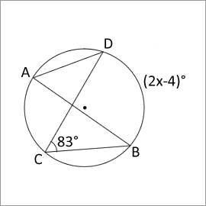
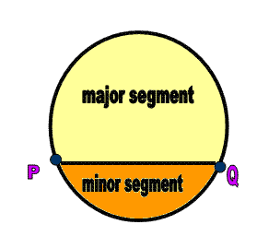
10. An angle inscribed in a major segment (see below) is always _________.
a) Acute b) Obtuse c) Right angle
d) Supplementary angle
11. True or False: The vertex of an inscribed angle can be outside the circle as long as its sides intersect the circle to form an intercepted arc.
12. True or False: In the given figure x=85 .

Slide 62
10. An angle inscribed in a major segment is always Acute.
11. True or False: The vertex of an inscribed angle can be outside the circle as long as its sides intersect the circle to form an intercepted arc. FALSE
12. True or False: In the given figure x = 85. TRUE

Slide 63
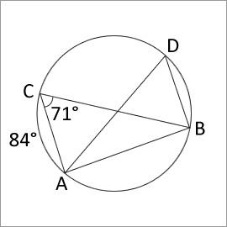
13. In the given figure find the measure of angle ADB.
A) 28 degrees
B) 142 degrees
C) 48 degrees
D) 71 degrees

Slide 64
13. In the given figure find the measure of angle ADB.
Answer:
D) 71 degrees

Slide 65
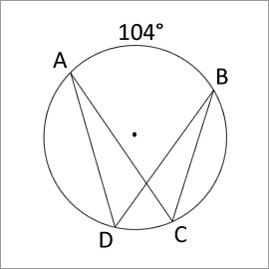
14. In the given figure find the measure of angle ADB.
A) 104 degrees
B) 52 degrees
C) 208 degrees
D) 90 degrees

Slide 66
14. In the given figure find the measure of angle ADB.
Answer:
B) 52 degrees

Slide 67
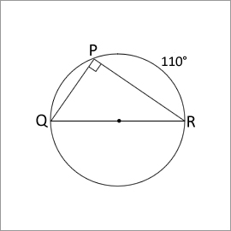
15. True or False: In the given figure the measure of angle PRQ is 45 degrees.

Slide 68
15. True or False: In the given figure the measure of angle PRQ is 45 degrees. FALSE

Slide 69
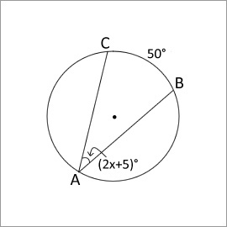
16. Find the value of 'x' in the given figure.

Slide 70
16. Find the value of 'x' in the given figure.
x = 10

Slide 71
Back to the White House….
Where else could you have taken your picture from to get the same frame of the White House? Where do you think the best place to stand would be? Your line of sight in the camera is marked in the picture as the grey lines. The white dotted arcs do not actually exist, but were added to help with this problem.

Slide 72
Filling the Room Over, Around, and Within Geometry and Measurement
EMPowerTM
extending mathematical power

Slide 73
Objectives (Filling the Room)
Describe the method for finding the capacity of a rectangular solid.
Determine the three dimensions considered in finding the volume of a rectangular solid: length, width, and height.

Slide 74
Filling the Room
This room will soon be converted into a storage room. It will be filled with boxes of files because the front-office workers want all their paperwork kept in one spot.
You have a sample box that will be used to store all paperwork.
Make a plan to determine how many boxes can fit into this room.
Show all work on a chart paper to share with the group.
How many boxes will fit into this room? ________

Slide 75
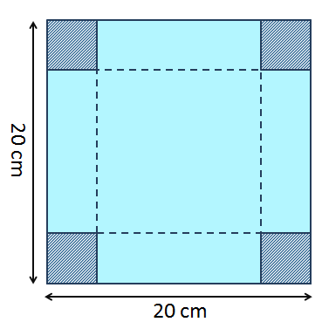
Cuboid Challenge
From a square sheet of paper 20 cm by 20 cm, we can make a box without a lid. We do this by cutting a square from each corner and folding up the flaps.
Will you get the same volume irrespective of the size of the squares that are cut out? Investigate what volumes are possible for different sizes of cut-out squares. What is the maximum possible volume and what size cut produces it?

Slide 76
Cuboid Challenge EXTENSION
Try different sized square sheets of paper. Can you find a relationship between the size of paper and the size of cut that produces the maximum volume?

