Slide 1
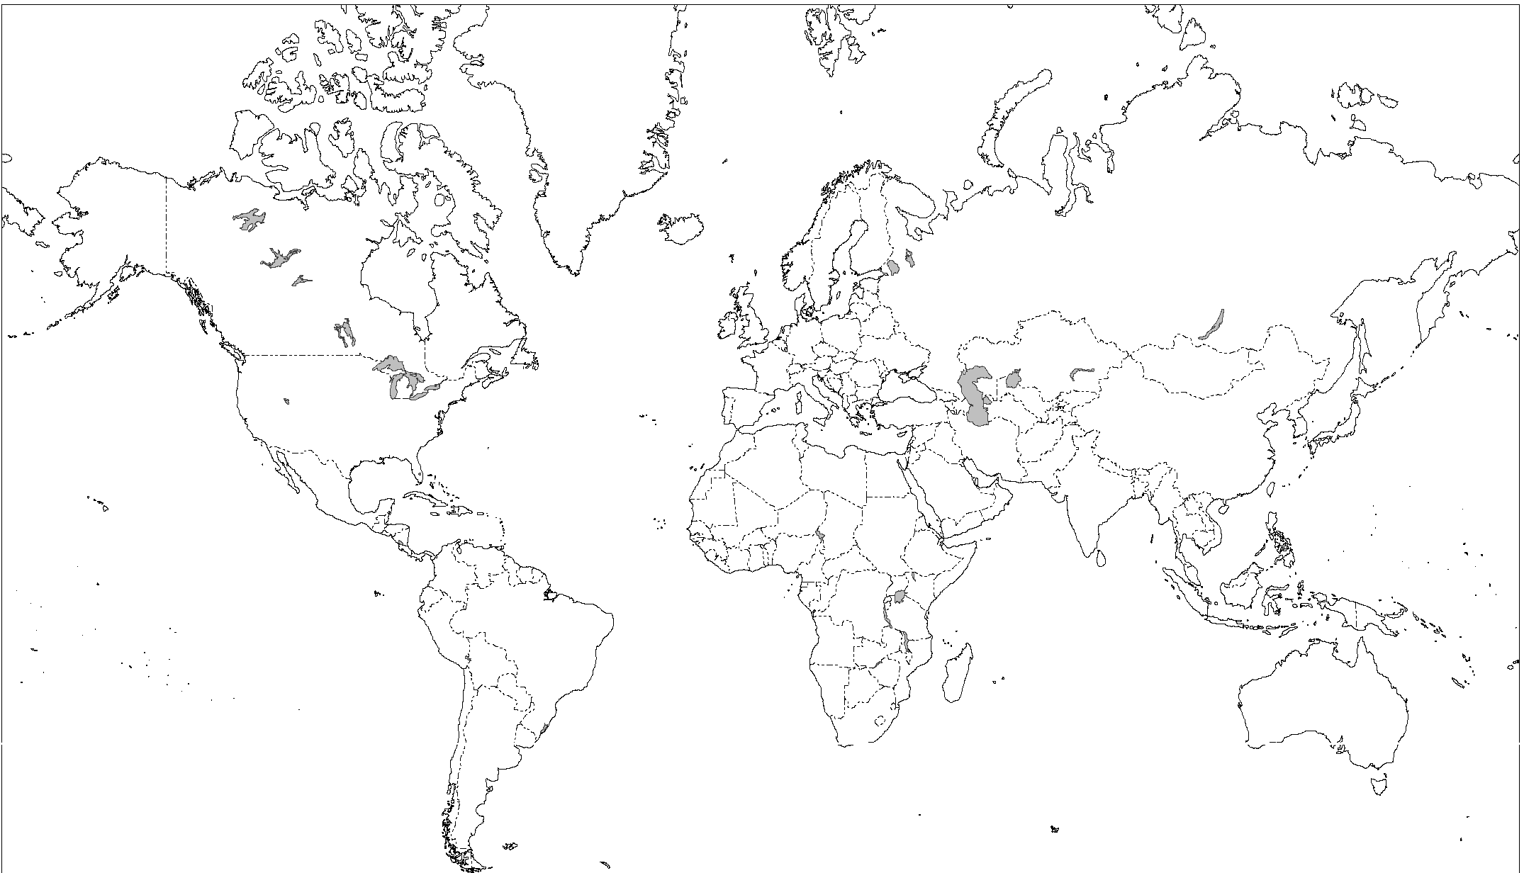
3.
4.
1.
6.
7.
2.
8.
5.

Slide 2
Dominican Republic
3.
4.
Haiti
Mexico
1.
6.
Senegal
7.
2.
Yemen
8.
Ecuador
India
5.
Brazil

Slide 3
3.
2.
1.
Great Britain

Slide 4
Scotland
Wales
England
Great Britain

Slide 5
Scotland
Northern
Ireland
Wales
England
The United Kingdom (U.K.)

Slide 6
4.
3.
2.
1.
The United Kingdom (U.K.)

Slide 7
Europe

Slide 8
Europe
England
France
Portugal
Spain

Slide 9
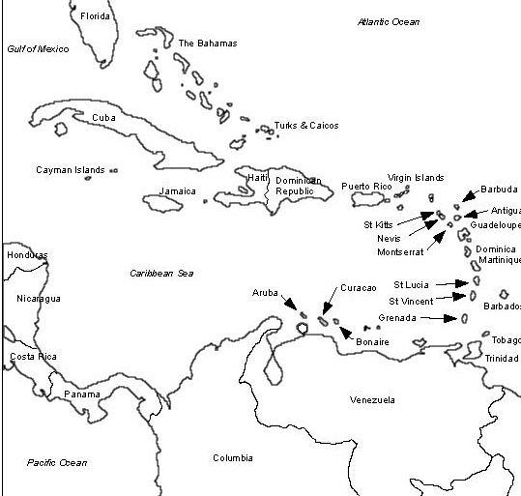
The Caribbean

