Slide 1
From Draft to Finish! 
Improved Reading and Writing
in the Adult Education Classroom
Presented by the
New York City Department of Education
Office of Adult and Continuing Education
Rose-Marie Mills, Superintendent
Luckisha Amankwah, Assistant Principal/Facilitator

Slide 3
Let’s Connect!
The unexamined life is not worth living.
Socrates
Read Dunbar’s poem, Life.
What is the author saying?
What is your perspective on life?
Share

Slide 4
The Foundation: Key Points
Foreword
Chapter 1
Developing passion for reading…
The purpose of education is… Two ideas…
“…Misinterpretation of the new standards has led to…”
Modeling
Rereading
Read the excerpt in your packet.
List 3 important points.
Notes:
Facilitator summarizes the foreword. The participants read the excerpt from Chapter 1 and share ideas.

Slide 5
“… I hope our students find relevance in their lives, forge deep connections with others, create art, appreciate the world’s mysteries, and possess spiritual and emotional stores that sustain them in dark times. Reading shows us how to be better human beings, not just successful worker bees.”

Slide 6
“We agree and believe that close reading takes clear, engaging, transferable, and responsive instruction. Close reading instruction must lead to students’ own thoughtful reading.”
“Students deserve instruction that moves them forward as readers and thinkers…”

Slide 7
Our Goals
Engage in reading, writing, and discussion and use our experiences as readers and writers to modify instruction
Learn strategies for developing close reading skills in a community of writers
Apply close reading skills to two genres
Reflect on the process of writing instruction

Slide 8
The Process for  Close Reading Instruction… and Writing
Draft
Generating or extracting ideas
Analysis
Examining of different aspects of craft
Finish
Polishing
Lenses
Patterns
Understandings

Slide 9
☹The Framework…
Understanding
Patterns 
Lens


Slide 10
Analysis Strategy I Lens: Craft and Structure
Text: Paul Laurence Dunbar’s, Life
A crust of bread and a corner to sleep in,
A minute to smile and an hour to weep in,
A pint of joy to a peck of trouble,
And never a laugh but the moans come double;
And that is life!

Slide 11
Analysis II  Lens: Detail/Word Choice
Text: We Wear the Mask, Dunbar
We wear the mask that grins and lies,
It hides our cheeks and shades our eyes,
This debt we pay to human guile;
With torn and bleeding hearts we smile,
And mouth with myriad subtleties.

Slide 12
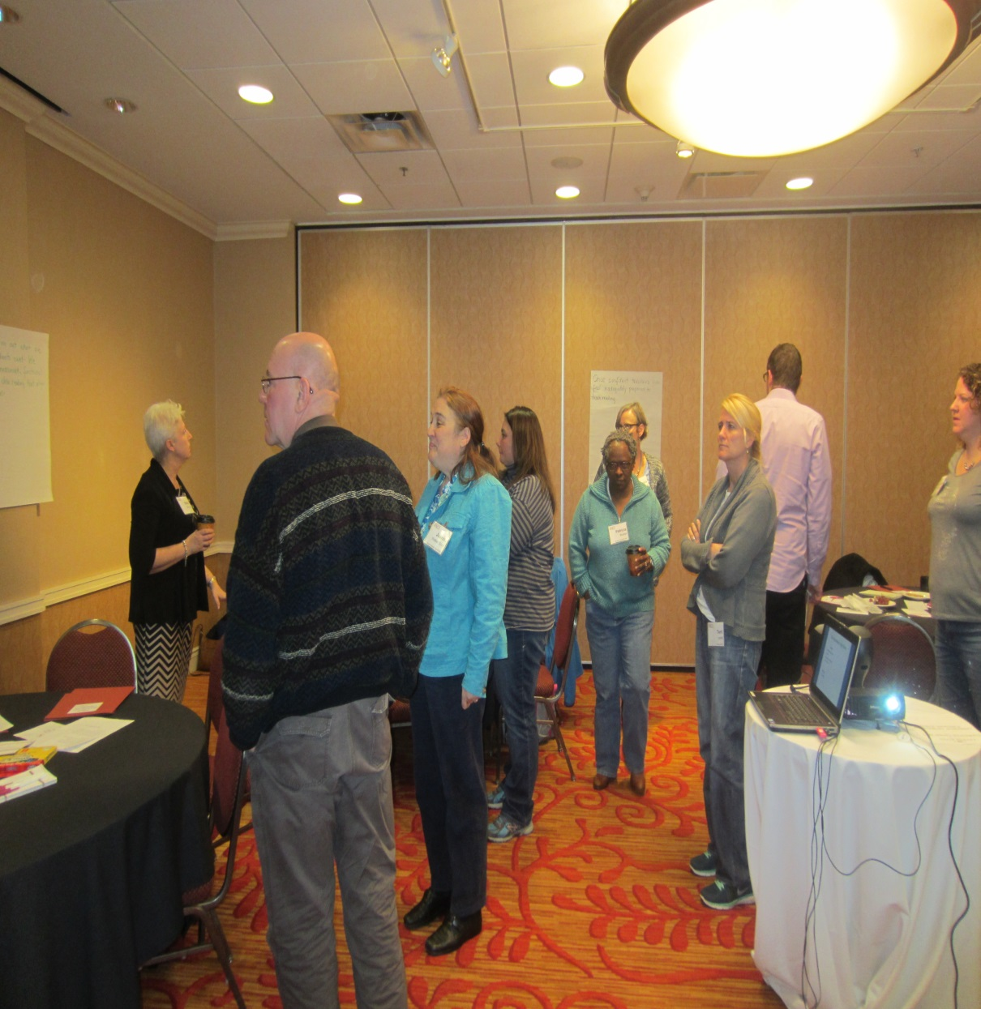
Group Work & Gallery Walk
As a group, draft a paragraph about the author’s perspectives on life.
Refer to your initial responses and discussion.
Post your group’s piece using chart paper.
Read the room!
What do you notice?

Slide 13
Lunch !

Slide 14
Analysis III  Lens: Word/Detail Choice
Read and annotate the text titled ‘No Indictment’
Use the tool provided to list:
1) a detail of interest
2) the impact it had on you/author’s intention
3)an alternative detail or writer decision that would change the tone or argument
Skills
Detecting Bias
Recognizing Author’s Purpose
Reflection
Can we determine how the author feels about this decision ?
What patterns have we detected?
What will we model for students about writing with a purpose?

Slide 15
Video Viewing
Video Viewing
Analysis of Student work
Reflection on teacher practice
Reflection on teacher impact on student writing

Slide 16
Read Aloud
Stories of Courage by Clare Gray
Which lens would be best suited to this text?
Which patterns are easiest to recognize?
Which patterns are easy to model or replicate for our students?

Slide 17
Resources
Anchor standards
Sample Text
Craft analysis tools
Graphic organizers
Excerpts

Slide 18
Wrap Up and Reflection
What did we learn from each of the stories we read?
Life
We Wear the Mask
Indictment
Running for Her Life

